Slide 1

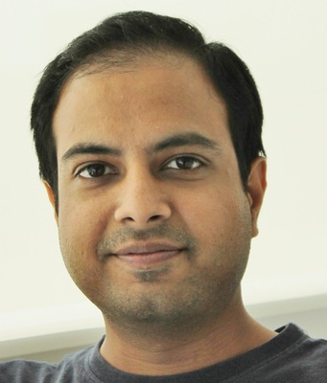

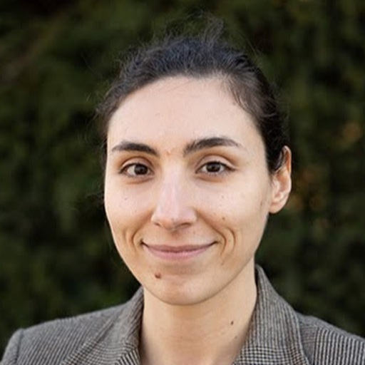
Deep Learning for Brain Encoding and Decoding
Subba Reddy Oota¹, Manish Gupta^{2,3}, Raju S. Bapi², Mariya Toneva⁴
¹Inria Bordeaux, France; ²IIIT Hyderabad, India; ³Microsoft, India; ⁴MPI for Software Systems, Germany
subba-reddy.oota@inria.fr, gmanish@microsoft.com, raju.bapi@iiit.ac.in, mtoneva@mpi-sws.org

Slide 2
Agenda
Introduction to Brain encoding and decoding [30 min]
Stimulus Representations [1 hour 30 min]
Coffee break [30 min]
Deep Learning for Brain Decoding [1 hour 30 min]
Lunch break [1 hour 15 min]
Deep Learning for Brain Encoding [1 hour 30 min]
Coffee break [30 min]
Advanced Methods [1 hour 15 min]
Summary and Future Trends [15 min]

Slide 3
Agenda
Introduction to Brain encoding and decoding [30 min]
Stimulus Representations [1 hour 30 min]
Coffee break [30 min]
Deep Learning for Brain Decoding [1 hour 30 min]
Lunch break [1 hour 15 min]
Deep Learning for Brain Encoding [1 hour 30 min]
Classic findings & common approaches
More recent findings utilizing deep learning
Coffee break [30 min]
Advanced Methods [1 hour 15 min]
Summary and Future Trends [15 min]

Slide 4
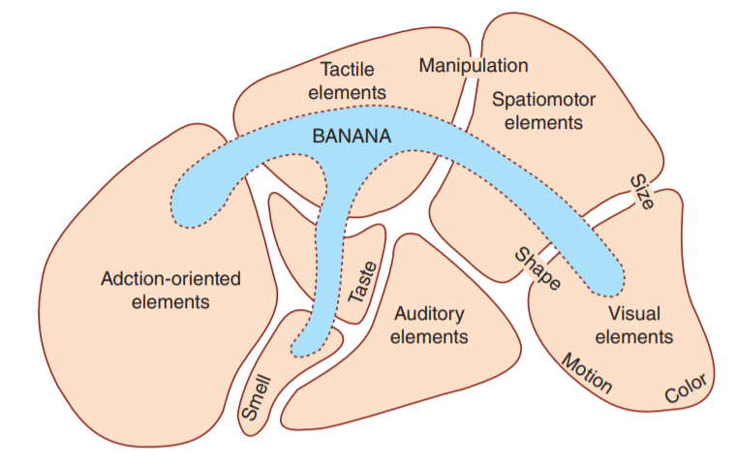
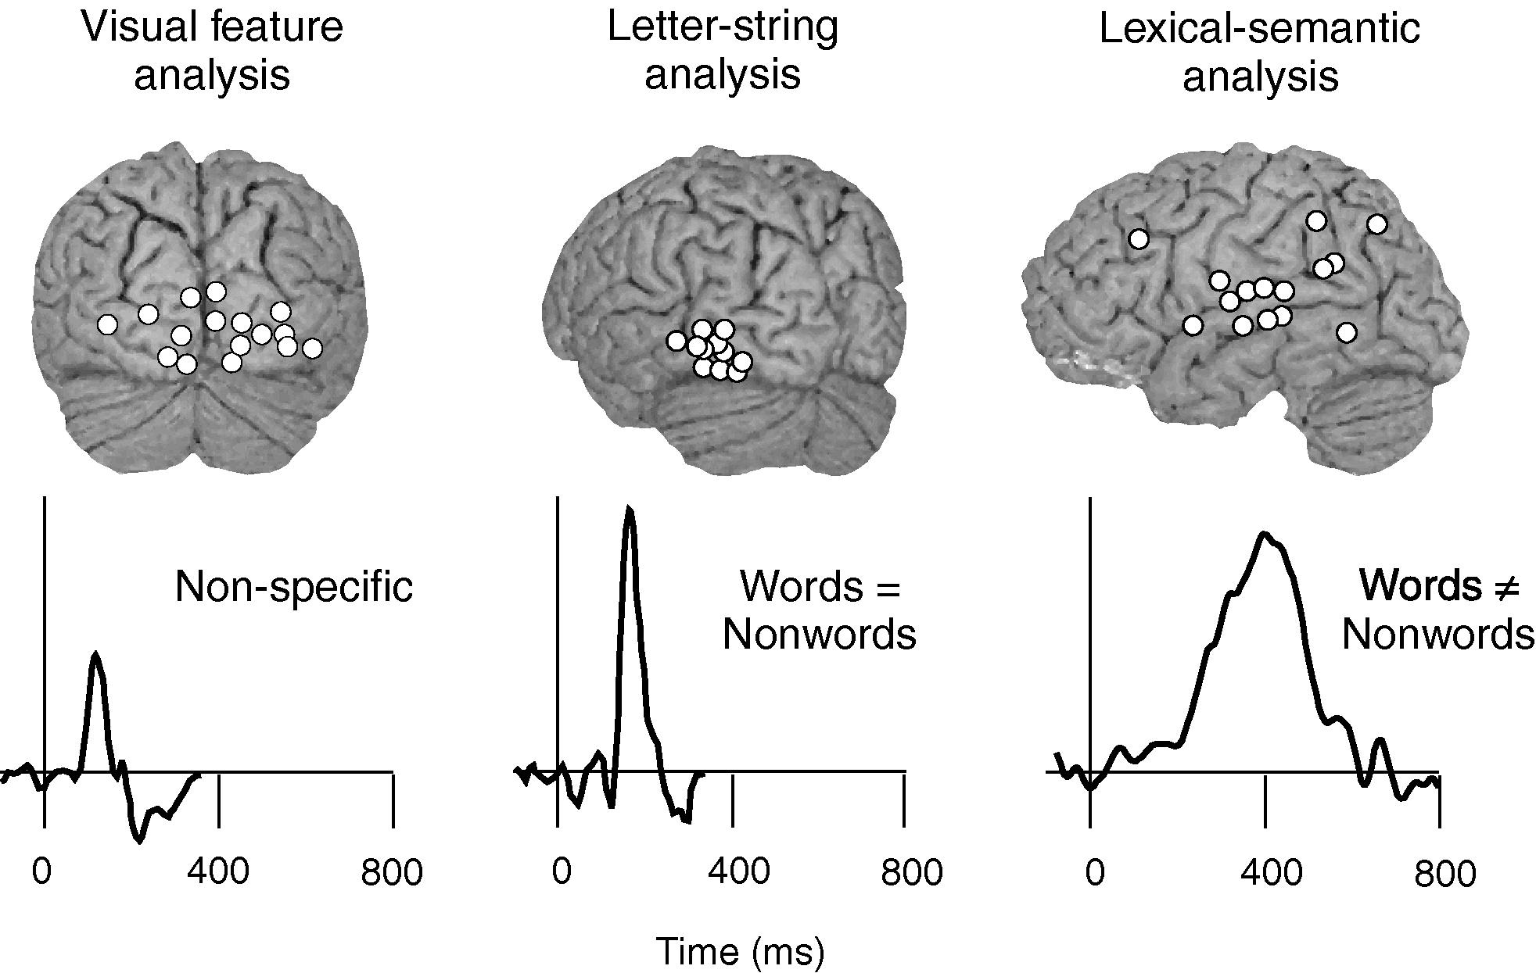
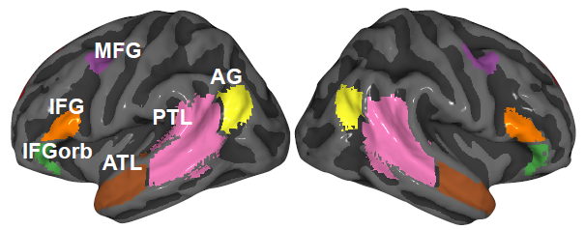
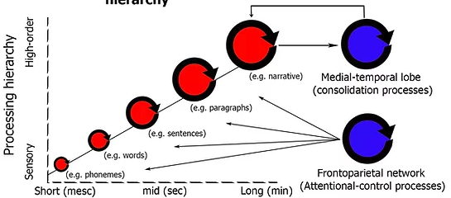
Mechanistic understanding of information processing in the brain: 4 big questions
What
When
Where
How

Slide 5


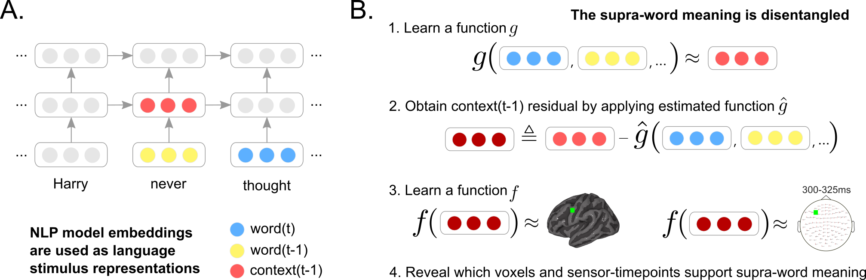


Encoding models have a causal interpretation
Reveal which brain areas are affected by stimulus properties [Weichwald et al. 2015]
y_{train}
Train:
<0,1,...0>
“The problem is when the capsule moves from an elliptical orbit to a parabolic orbit.”
^
Evaluate:
Y_{test}, Y_{test}
corr( )
stimulus properties
Part of Speech: Noun
stim. representation
<0, 1, … 0>
stimulus representation
= hypothesis for
latent brain-relevant
stimulus properties

Slide 6
Classic findings using encoding models
Using representations of stimuli not from deep learning
Language:
Mitchell et al. 2008, Science
Vision:
Kay et al. 2008, Nature
Audio:
Santoro et al. 2014, PLoS Comp Bio

Slide 7
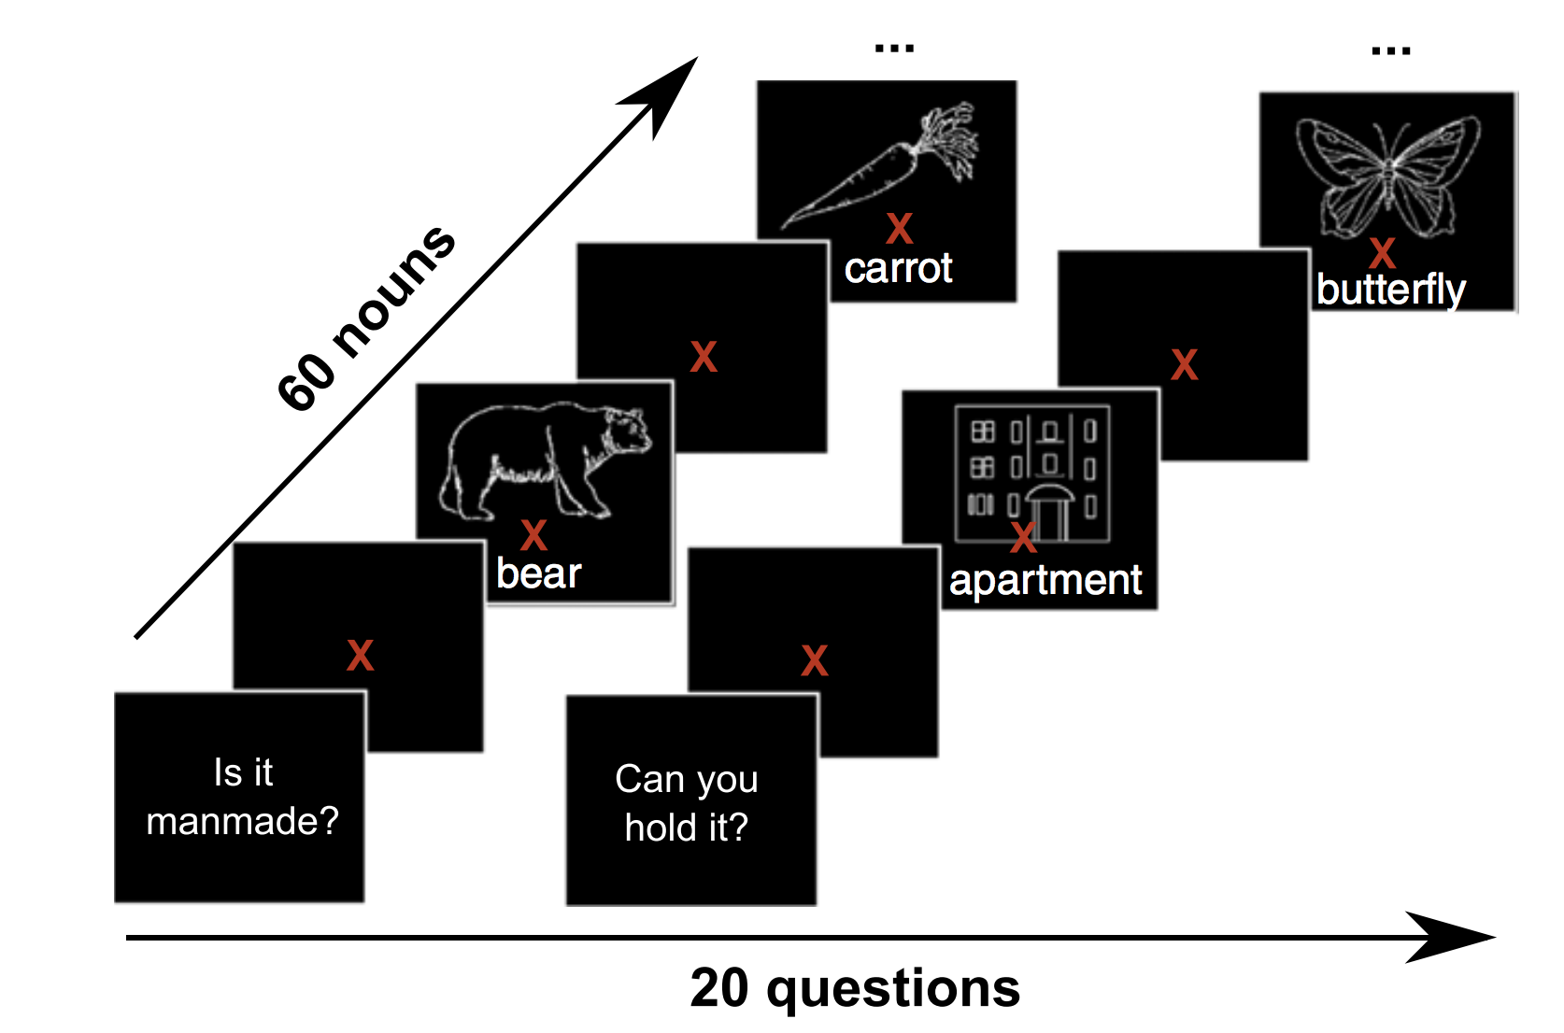
Classic encoding model finding: Language
bear
Stimuli: concrete nouns + line drawings
Stimulus representation: corpus co-occurrence counts with 25 sensory-motor verbs (e.g. see, hear, taste, smell)
Empirical evidence for distributed organization for attributes related to:
audition [Kiefer et al., 2008]
color [Simmons et al., 2007]
shape [Chao et al., 1999]
motion [Damasio et al., 1996]
olfaction and taste [Goldberg, Perfetti, et al., 2006a; Goldberg, Perfetti, et al., 2006b]
figure from Kemmerer, 2014; adapted from Thompson-Schill et al. 2006
[Barsalou, 1999; Barsalou, 2008; Pecher et al., 2005]
Mitchell, Tom M., Svetlana V. Shinkareva, Andrew Carlson, Kai-Min Chang, Vicente L. Malave, Robert A. Mason, and Marcel Adam Just. "Predicting human brain activity associated with the meanings of nouns." science 320, no. 5880 (2008): 1191-1195.

Slide 8
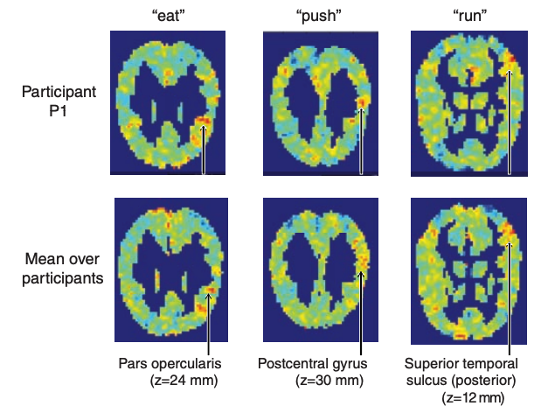
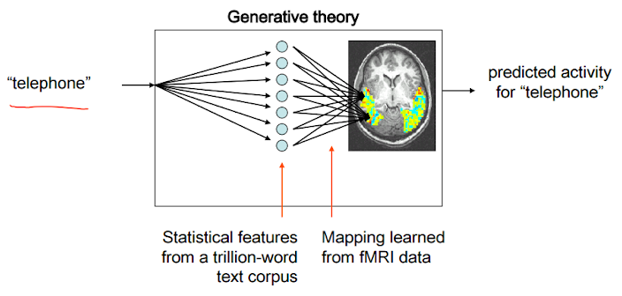
Classic encoding model finding: Language
bear
Stimuli: concrete nouns + line drawings
Stimulus representation: corpus co-occurrence counts with 25 sensory-motor verbs (e.g. see, hear, taste, smell)
Brain recording: fMRI
Correspondences
between a semantic property (“push”) and the function of the cortical regions where the fMRI recordings are well predicted
Accurately predicts fMRI recordings for a novel word
Mitchell, Tom M., Svetlana V. Shinkareva, Andrew Carlson, Kai-Min Chang, Vicente L. Malave, Robert A. Mason, and Marcel Adam Just. "Predicting human brain activity associated with the meanings of nouns." science 320, no. 5880 (2008): 1191-1195.

Slide 9
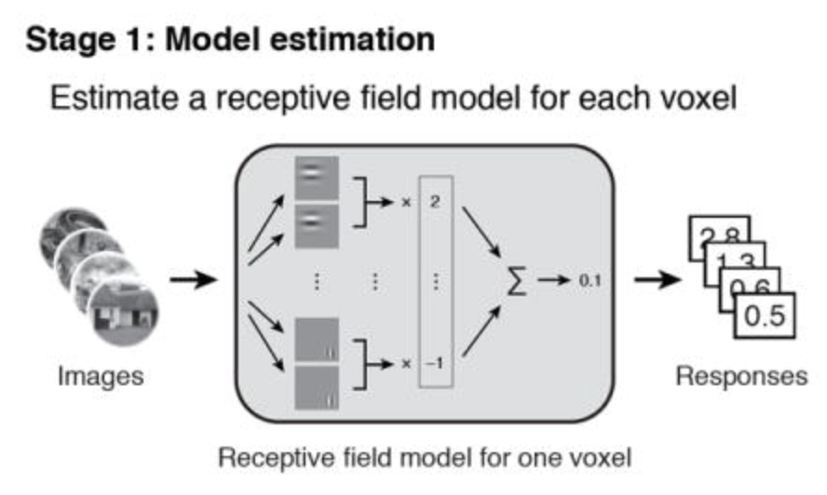
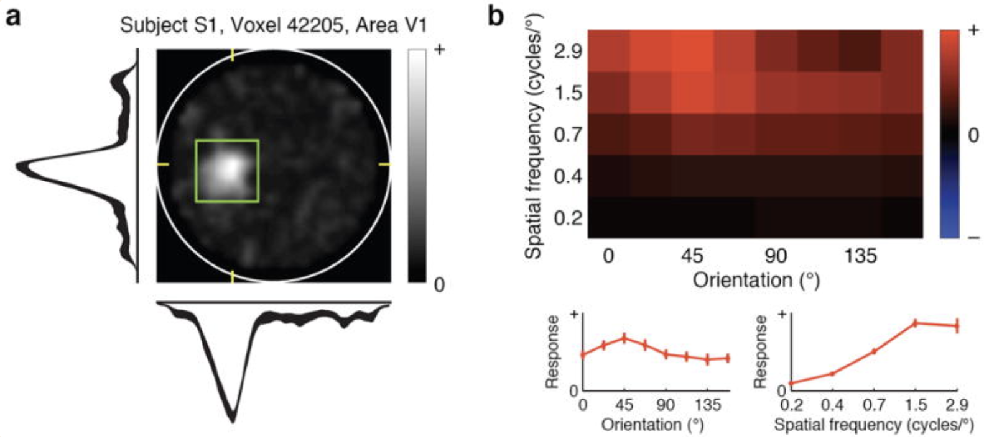
Classic encoding model finding: Vision
Stimuli: natural images
Stimulus representation: mixtures of Gabor wavelets
Brain recording & modality: fMRI, viewing
Encoding models estimated quantitative receptive fields for V1-V3 voxels
Identified which of a set of candidate natural image was viewed by a participant
Kay, Kendrick N., Thomas Naselaris, Ryan J. Prenger, and Jack L. Gallant. "Identifying natural images from human brain activity." Nature 452, no. 7185 (2008): 352-355.

Slide 10
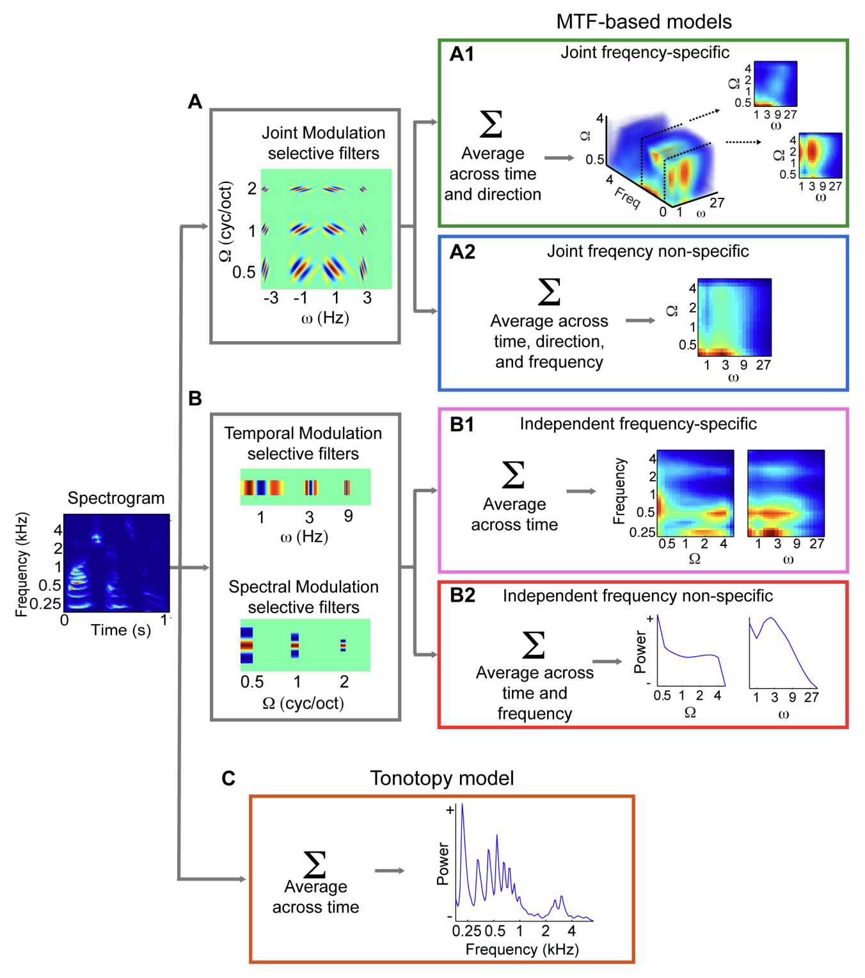
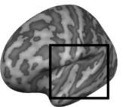
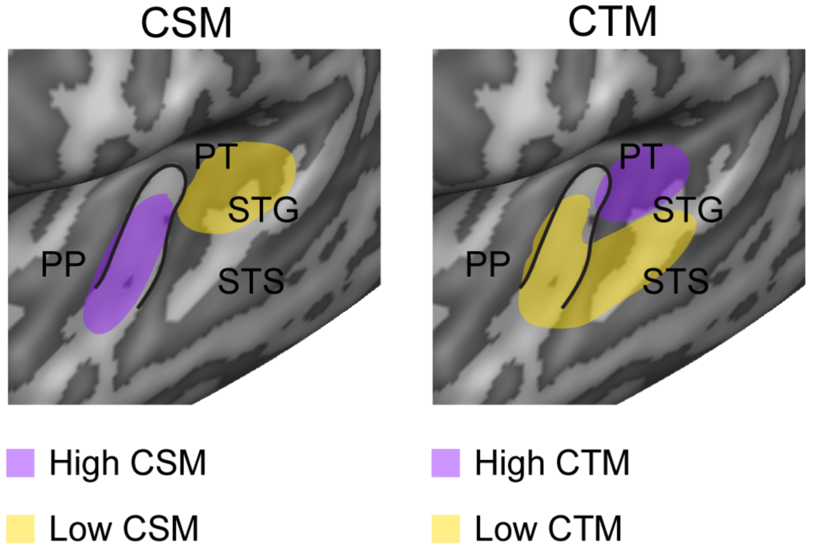
Classic encoding model finding: Audio
Stimuli: natural sounds (speech, music, nature, tools)
Stimulus representation: spectro-temporal filters that are selective for modulations along space and/or time
Brain recording & modality: fMRI, listening
spatial
temporal
posterior/dorsal auditory: coarse spectral info & high temporal precision
anterior/ventral auditory: fine-grained spectral & low temporal precision
Santoro, Roberta, Michelle Moerel, Federico De Martino, Rainer Goebel, Kamil Ugurbil, Essa Yacoub, and Elia Formisano. "Encoding of natural sounds at multiple spectral and temporal resolutions in the human auditory cortex." PLoS computational biology 10, no. 1 (2014): e1003412.

Slide 11
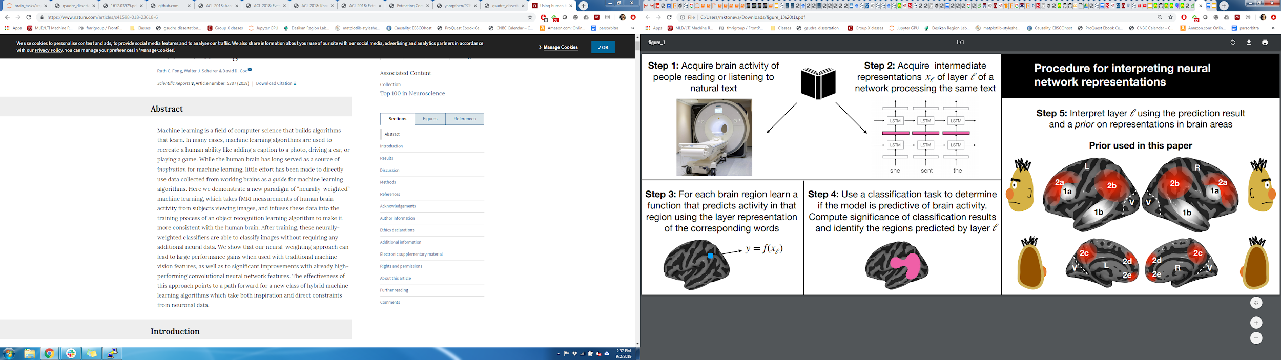

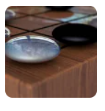

Deep learning models enable data-driven encoding models for naturalistic stimuli
more naturalistic stimuli
more stimulus properties that affect brain activity
simple stim. representations explain less variance in brain activity
<0,1,...0>
DeepMind’s New AI Taught Itself to Be the World’s Greatest Go Player
Singularity Hub
Meet GPT-3. It Has Learned to Code (and Blog and Argue)
The New York Times

Slide 12
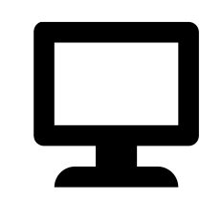

Data-driven encoding models evaluate the relationships between brains and deep learning models
Multimodal naturalistic stimulus
Deep learning system
A priori locations in DL system and brain
Data-driven encoding model
how are they related?
fMRI

Slide 13
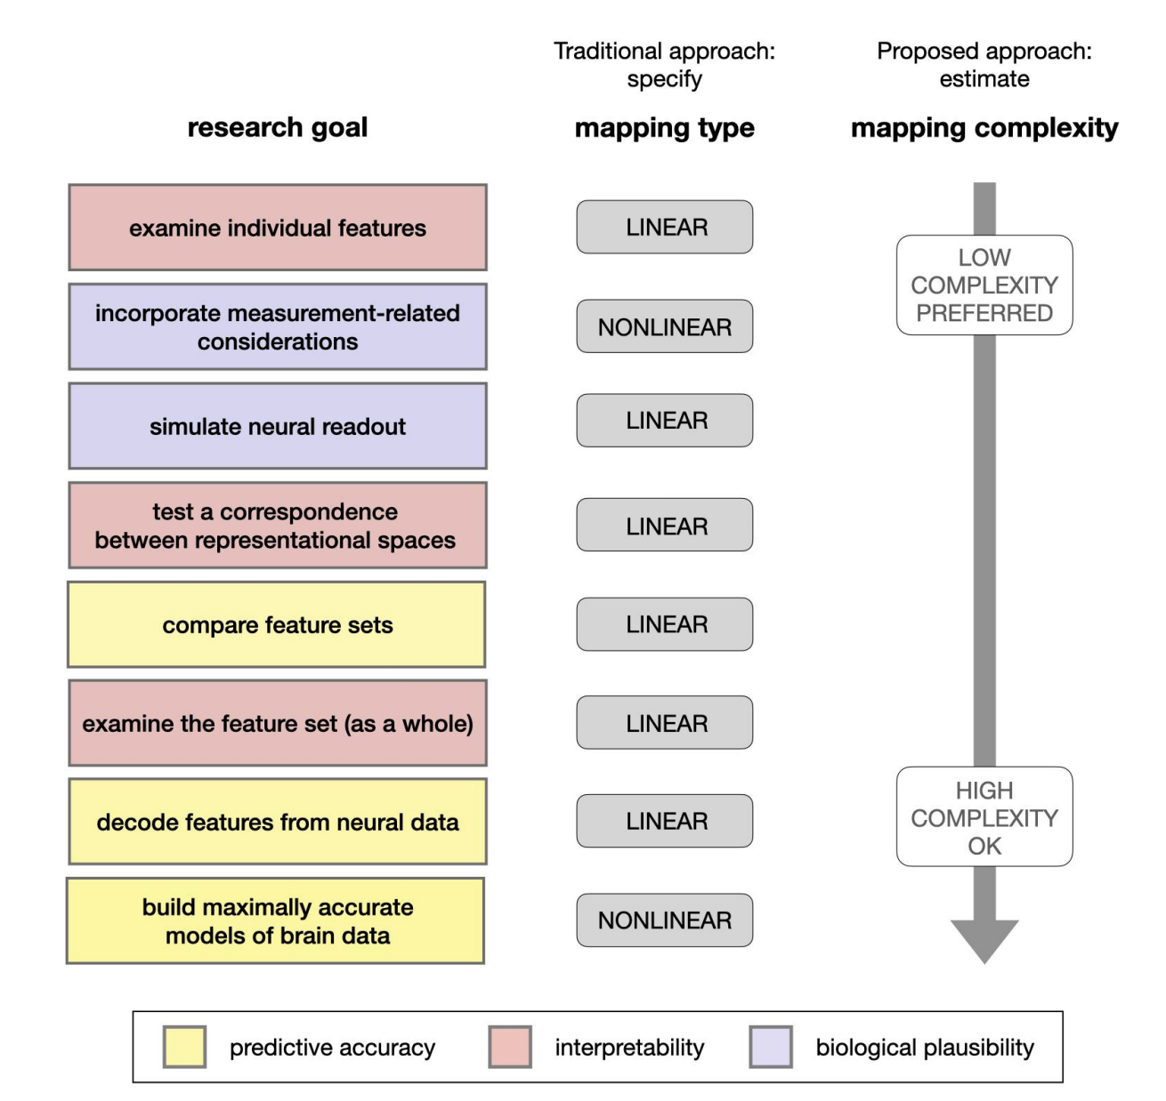
Encoding: training and evaluation
function often modeled as linear
[Mitchell et al. 2008, Nishimoto et al., 2011;
Sudre et al., 2012; Wehbe et al., 2014]
Considerations for
Linear vs non-linear
Ivanova, Anna A., Martin Schrimpf, Stefano Anzellotti, Noga Zaslavsky, Evelina Fedorenko, and Leyla Isik. "Is it that simple? Linear mapping models in cognitive neuroscience." bioRxiv (2021).

Slide 14
Encoding: training and evaluation
function often modeled as linear
[Mitchell et al. 2008, Nishimoto et al., 2011;
Sudre et al., 2012; Wehbe et al., 2014]
Training: cross validation (CV), regularization parameter chosen via nested CV
Evaluation: 1) make predictions for heldout data
2) compare predictions with true brain data
3) stringent statistical testing

Slide 15
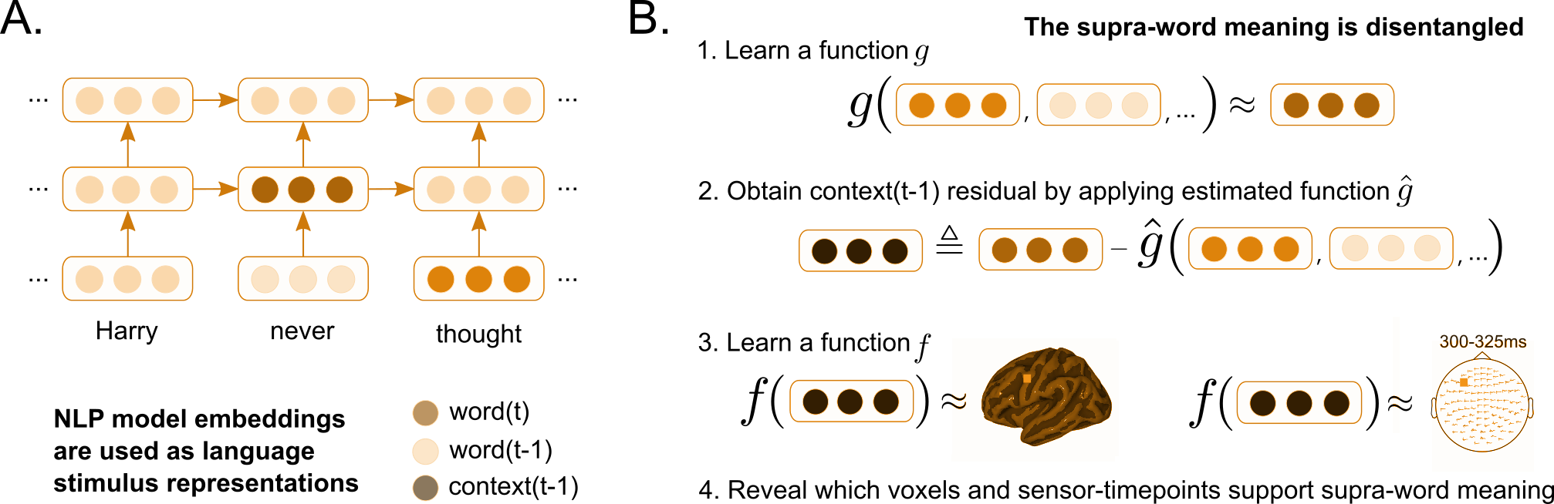
Encoding: training setup
Learn function
Goal: find a mapping from stimulus representation to brain data that generalizes to new brain data
Test how well predicts unseen brain recordings
Method:
Split dataset into train, validation, and test
Employ cross-validation to select model parameters based on validation dataset
Reduce overfitting by using regularization
Ridge regularization

Slide 16
Encoding: training independent models
Independent model per participant
P1
P2
…
PN
Independent model per voxel / sensor-timepoint
P1, v1
P1, v2
…
P1, vm

Slide 17
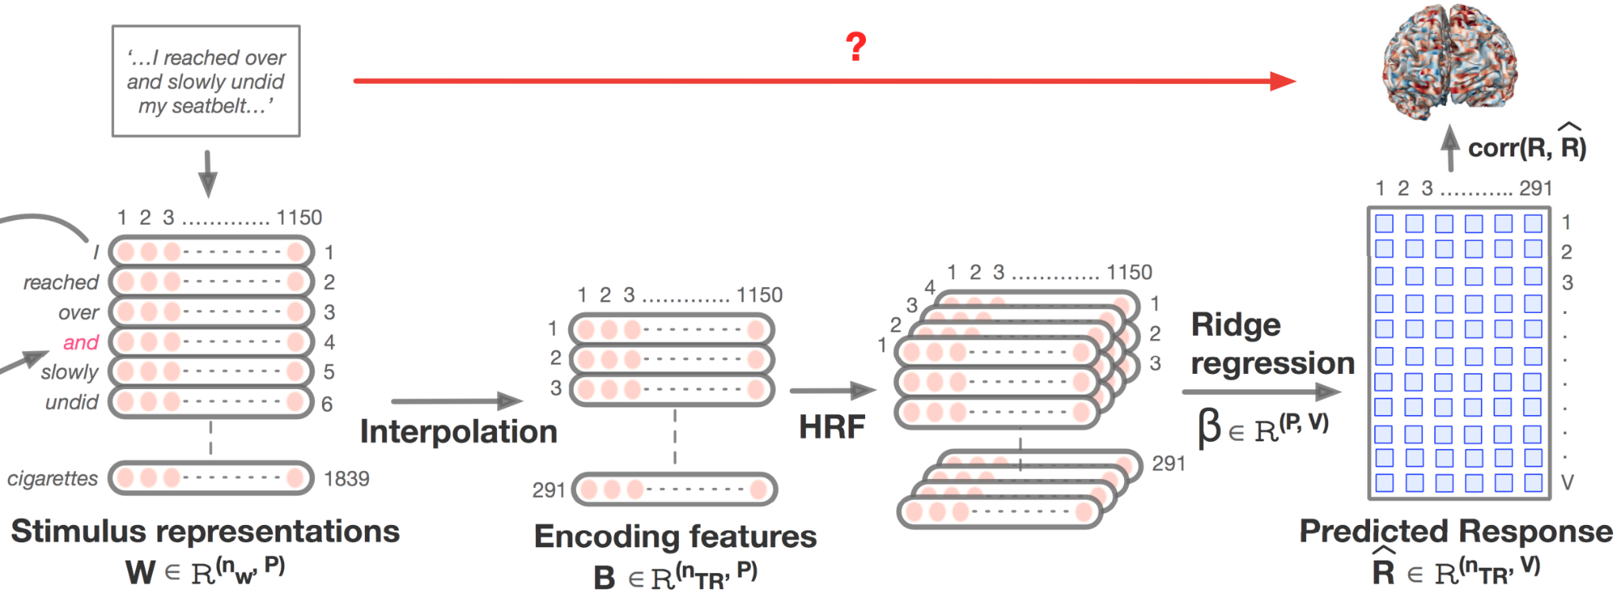
Encoding: fMRI specifics
Jain, Shailee, Vy Vo, Shivangi Mahto, Amanda LeBel, Javier S. Turek, and Alexander Huth. "Interpretable multi-timescale models for predicting fMRI responses to continuous natural speech." Advances in Neural Information Processing Systems 33 (2020): 13738-13749.

Slide 18
Encoding: evaluation setup
Predict data heldout from training by applying learned function to corresponding stimulus representations
Compare predictions of brain data to true brain data:
Evaluation metrics
Learn function
Test how well predicts unseen brain recordings

Slide 19
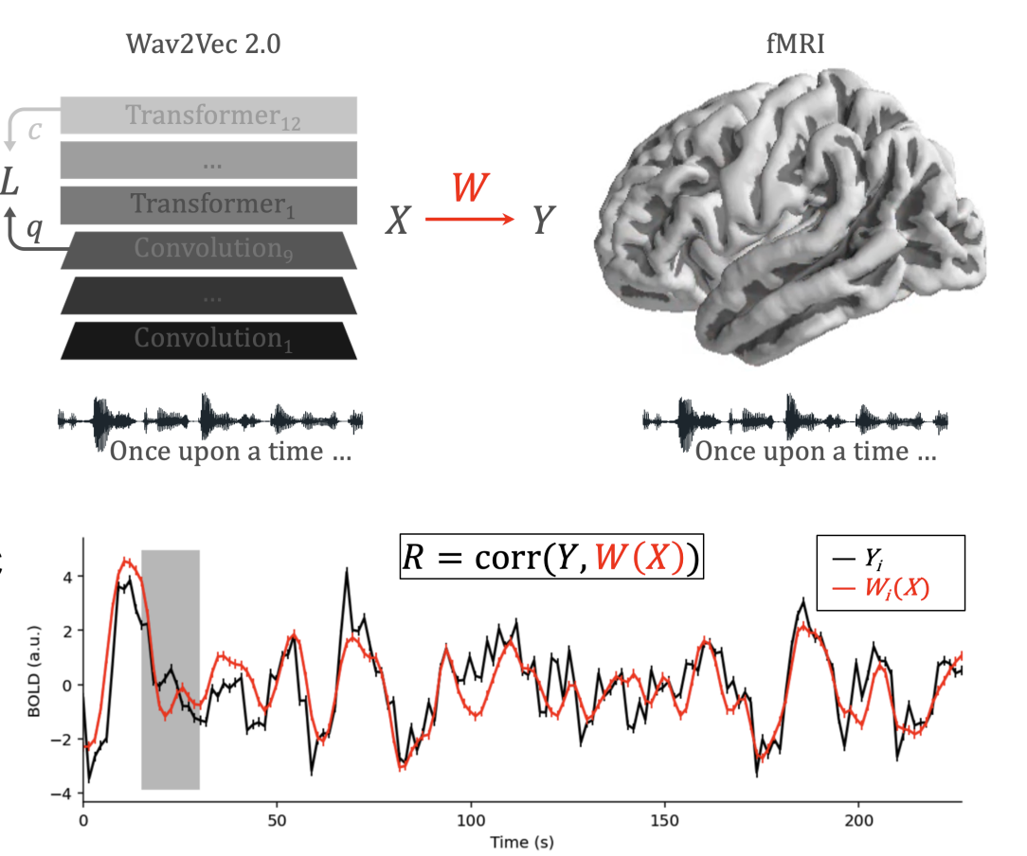
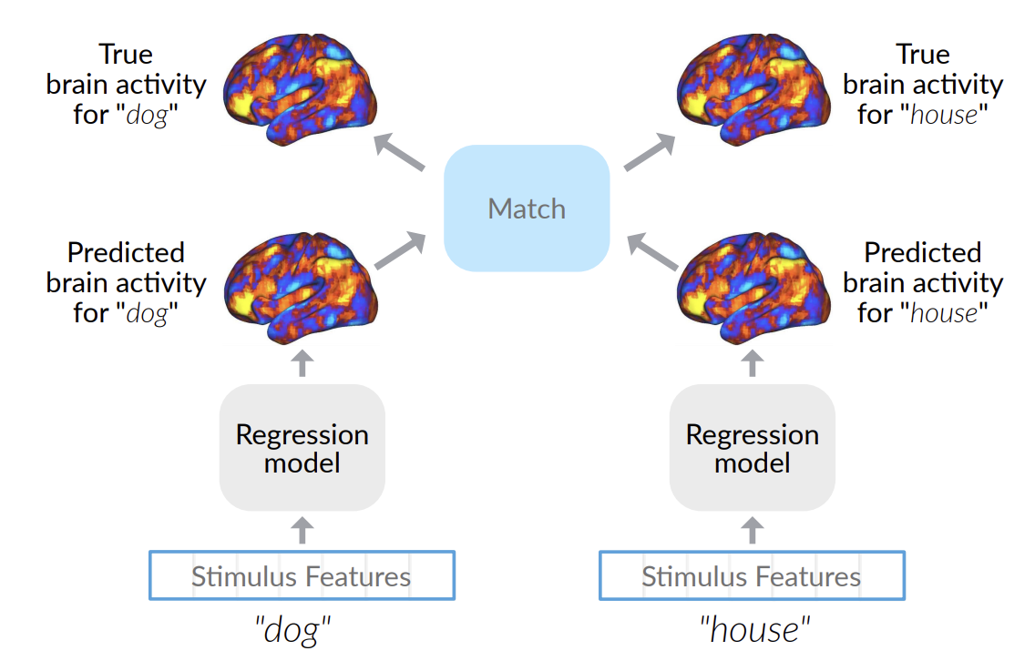
Encoding: evaluation metrics
Pearson correlation
2v2 accuracy
Millet, Juliette, Charlotte Caucheteux, Pierre Orhan, Yves Boubenec, Alexandre Gramfort, Ewan Dunbar, Christophe Pallier, and Jean-Remi King. "Toward a realistic model of speech processing in the brain with self-supervised learning." arXiv preprint arXiv:2206.01685 (2022).
Toneva, Mariya, Otilia Stretcu, Barnabás Póczos, Leila Wehbe, and Tom M. Mitchell. "Modeling task effects on meaning representation in the brain via zero-shot meg prediction." Advances in Neural Information Processing Systems 33 (2020): 5284-5295.

Slide 20
Encoding: statistical significance
Goal: determine whether the estimated similarity between the DL representations and the brain recordings is significant
Simple method that makes no assumptions about underlying data:
Permutation test
Break input-to-output correspondence by permuting output labels
Estimate similarity
Repeat 1000s times to estimate null distribution
P-value = proportion of times the similarity metric from permuted labels >= sim. metric from original labels
Specifically for fMRI:
Permute labels in blocks to preserve the autoregressive structure
Correct for multiple comparisons
FDR, FWER, etc.

Slide 21
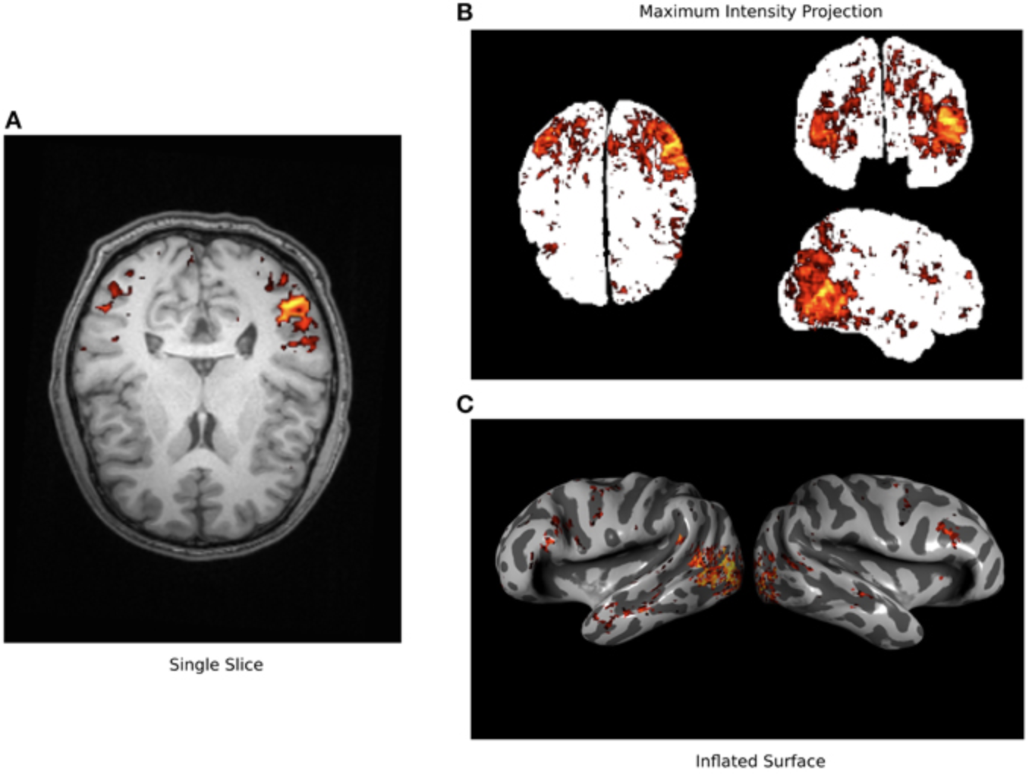
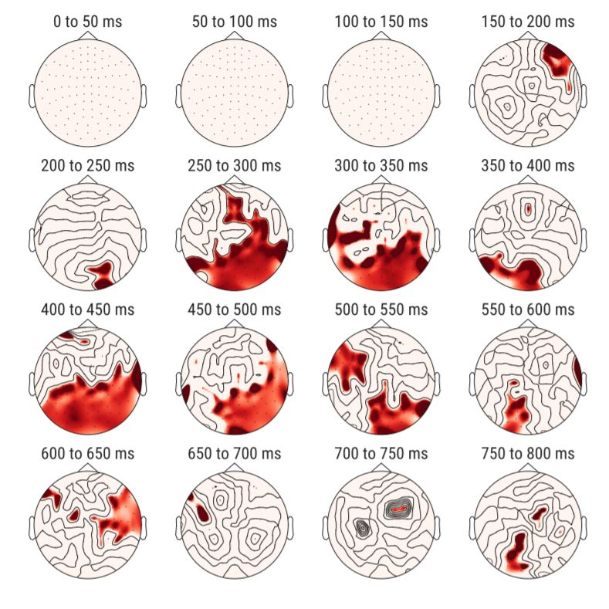
Encoding: performance visualization
fMRI
MEG/EEG
Gao, James S., Alexander G. Huth, Mark D. Lescroart, and Jack L. Gallant. "Pycortex: an interactive surface visualizer for fMRI." Frontiers in neuroinformatics (2015): 23.
Gramfort, Alexandre, Martin Luessi, Eric Larson, Denis A. Engemann, Daniel Strohmeier, Christian Brodbeck, Roman Goj et al. "MEG and EEG data analysis with MNE-Python." Frontiers in neuroscience (2013): 267.

Slide 22
Agenda
Introduction to Brain encoding and decoding [30 min]
Stimulus Representations [1 hour 30 min]
Coffee break [30 min]
Deep Learning for Brain Decoding [1 hour 30 min]
Lunch break [1 hour 15 min]
Deep Learning for Brain Encoding [1 hour 30 min]
Classic findings & common approaches
More recent findings utilizing deep learning
Coffee break [30 min]
Advanced Methods [1 hour 15 min]
Summary and Future Trends [15 min]

Slide 23
More recent work utilizing progress in DL for encoding
Using representations of stimuli from deep learning systems
Language:
Wehbe et al. 2014; Jain and Huth, 2018; Toneva and Wehbe, 2019; Caucheteux and King, 2020/2022; Schrimpf et al. 2020/2021; Goldstein et al. 2021/2022
Vision:
Yamins et al. 2014; Cichy et al. 2016; Konkle and Alvarez, 2020/2022; Zhuang et al. 2022
Audio:
Kell et al. 2018; Vaidya, Jain, and Huth 2022; Millet et al. 2022

Slide 24
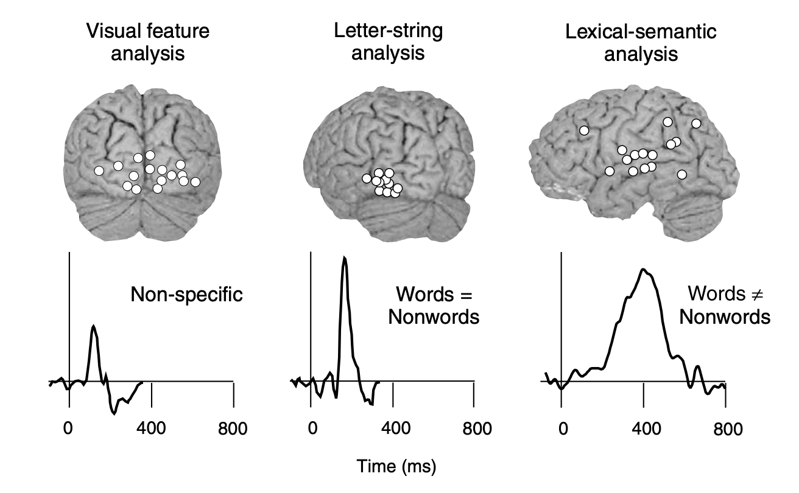
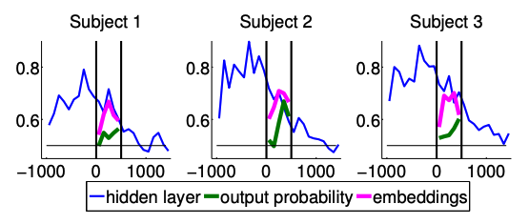
Language: work utilizing DL progress
Stimuli: one chapter of Harry Potter
Stimulus representation: derived from an NLP system (RNN) trained on Harry Potter fan fiction
Brain recording: MEG, reading
significant word-by-word alignment between MEG & representations of words and context from recurrent NLP systems
Wehbe, Leila, Ashish Vaswani, Kevin Knight, and Tom Mitchell. "Aligning context-based statistical models of language with brain activity during reading." In Proceedings of the 2014 Conference on Empirical Methods in Natural Language Processing (EMNLP), pp. 233-243. 2014.

Slide 25
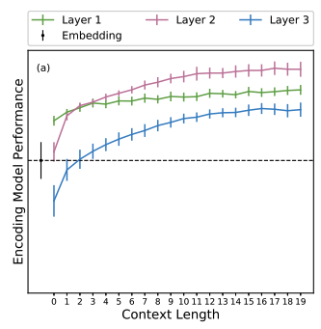
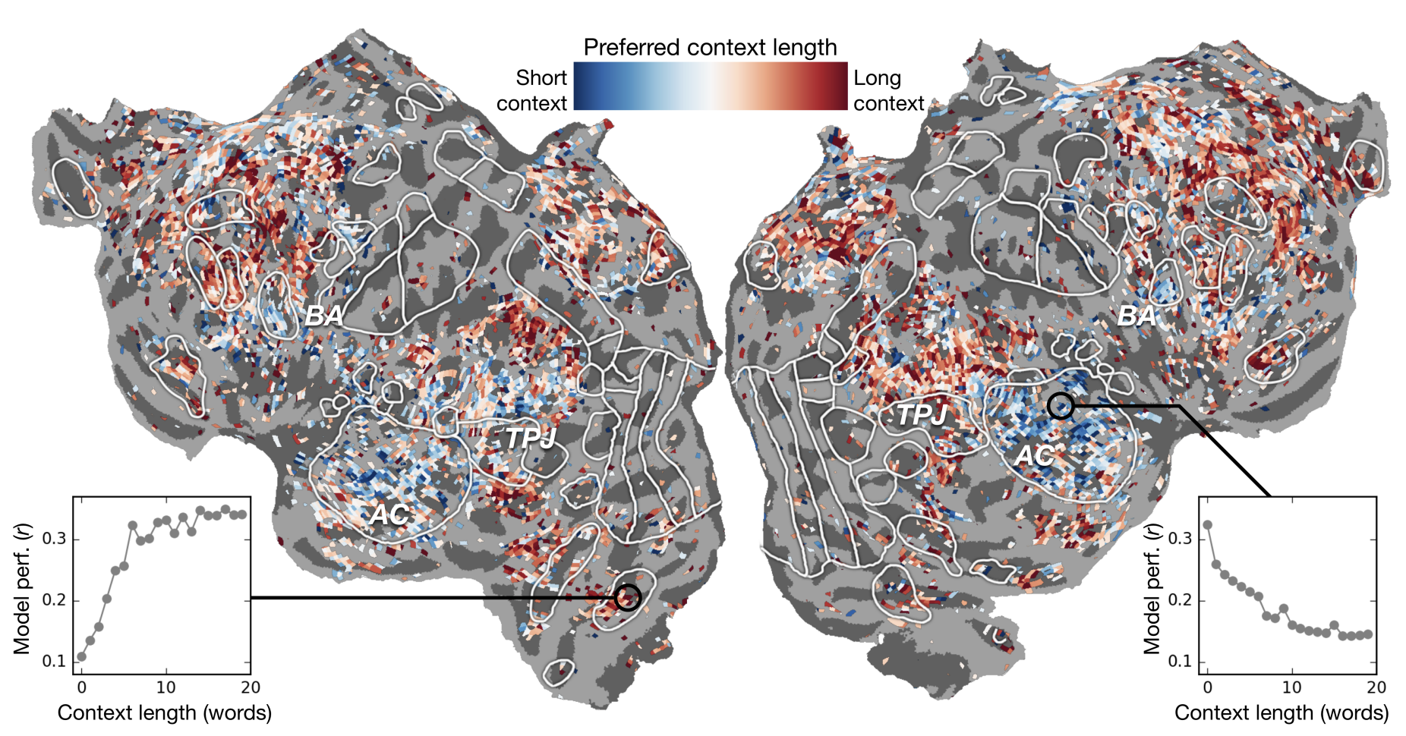
Audio: work utilizing DL progress
Stimuli: Moth Radio Hour
Stimulus representation: derived from self-supervised text language model trained to predict upcoming word in other radio stories
Brain recording & modality: fMRI, listening
alignment between fMRI & recurrent NLP representations w/ varying context;
best alignment with middle layer
Jain, Shailee, and Alexander Huth. "Incorporating context into language encoding models for fMRI." Advances in neural information processing systems 31 (2018).

Slide 26
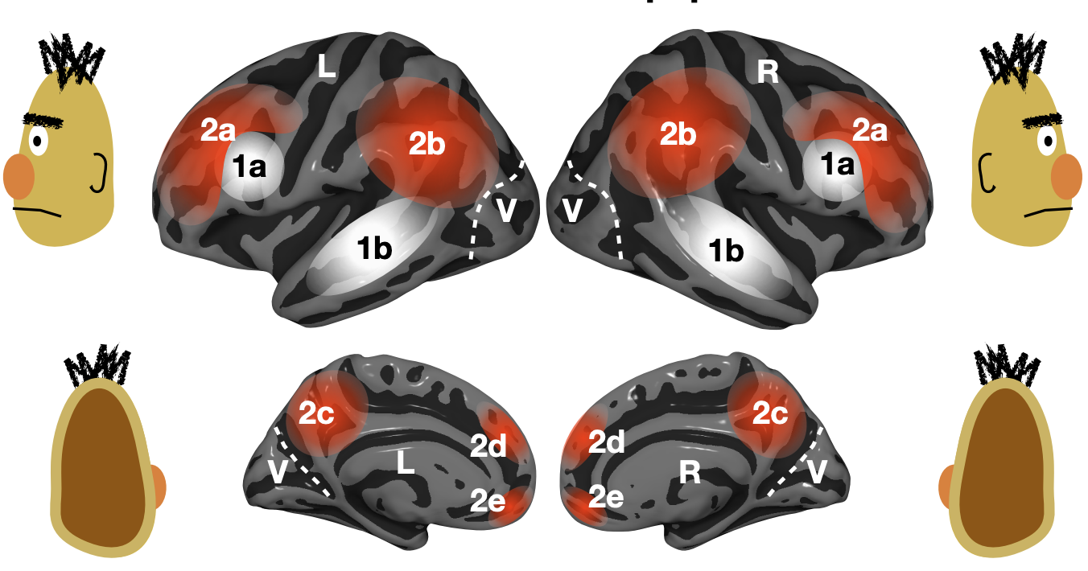
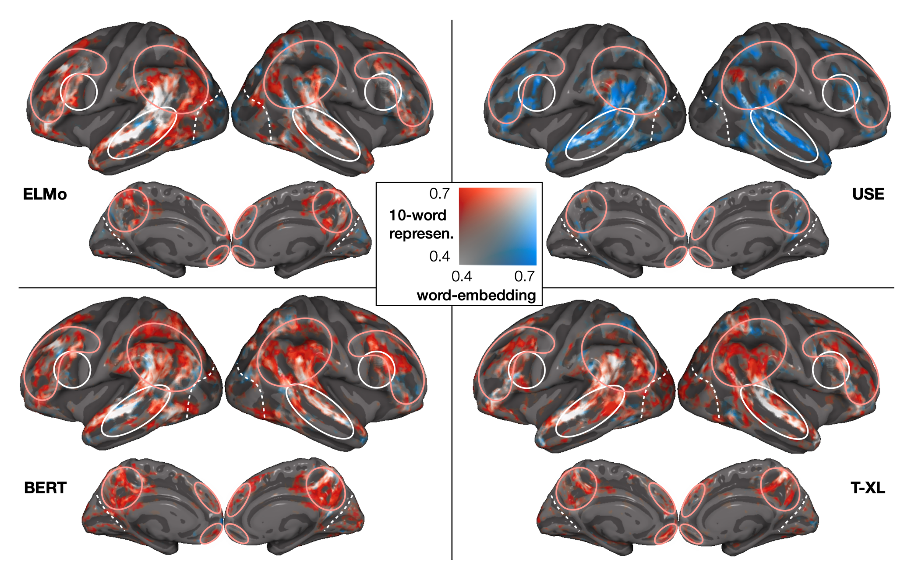
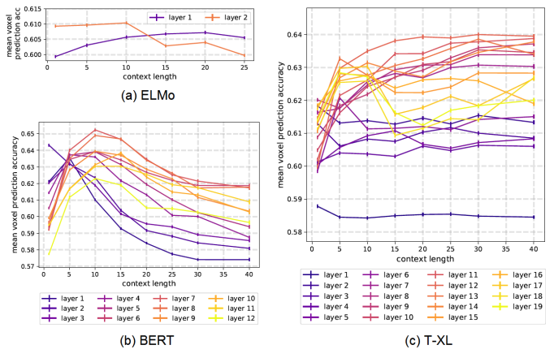
Language: work utilizing DL progress
Stimuli: one chapter of Harry Potter
Stimulus representation: derived from pretrained NLP systems
Brain recording & modality: fMRI, reading
across several types of large NLP systems, best alignment with fMRI in middle layers
Toneva, M., & Wehbe, L. (2019). Interpreting and improving natural-language processing (in machines) with natural language-processing (in the brain). Advances in Neural Information Processing Systems, 32.

Slide 27
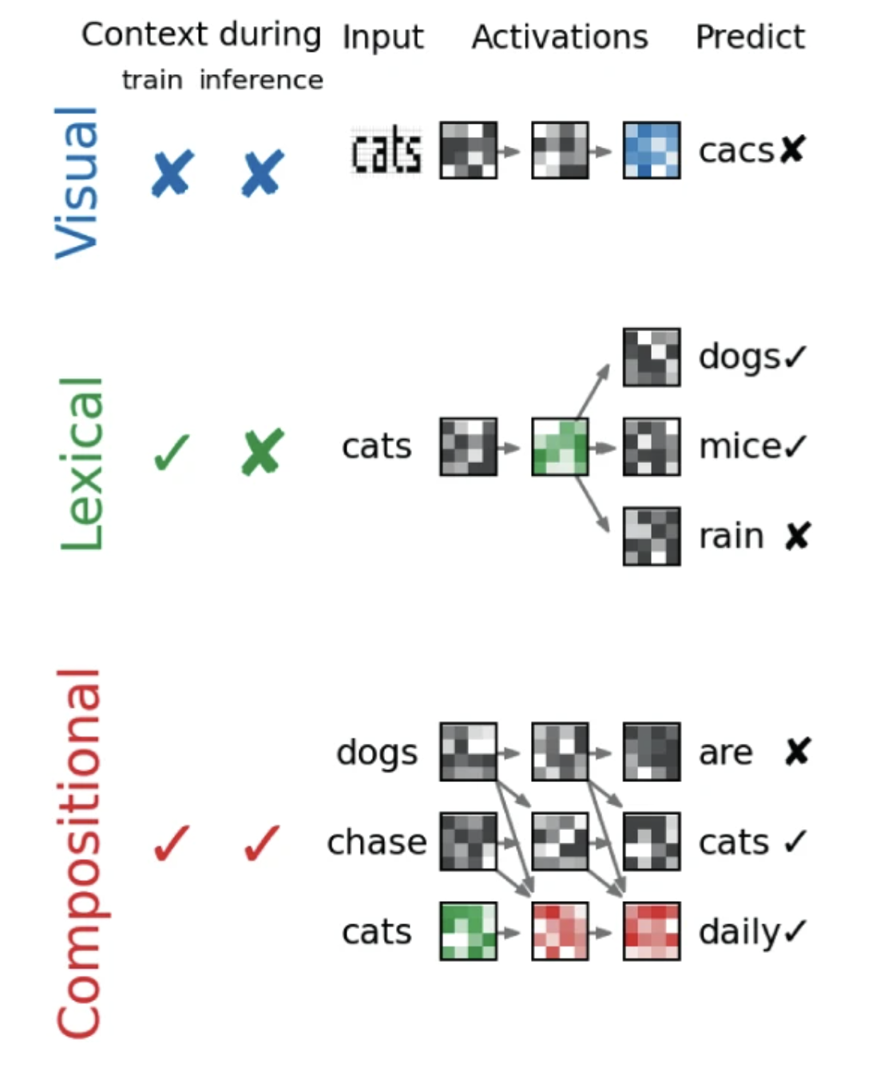
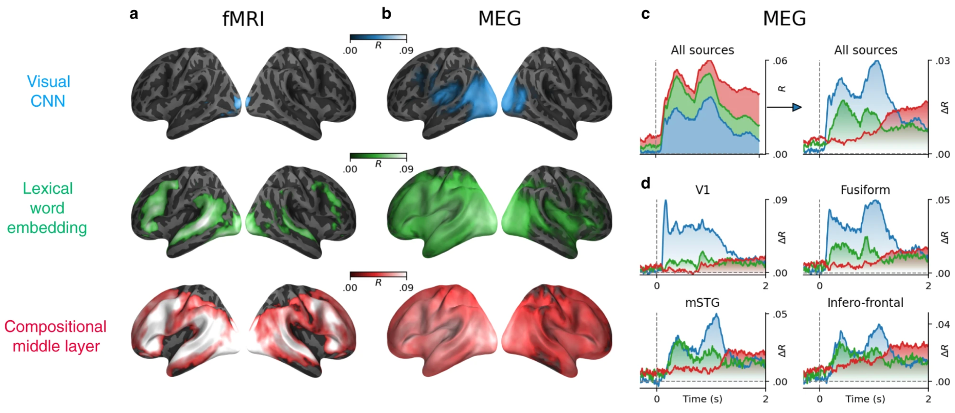
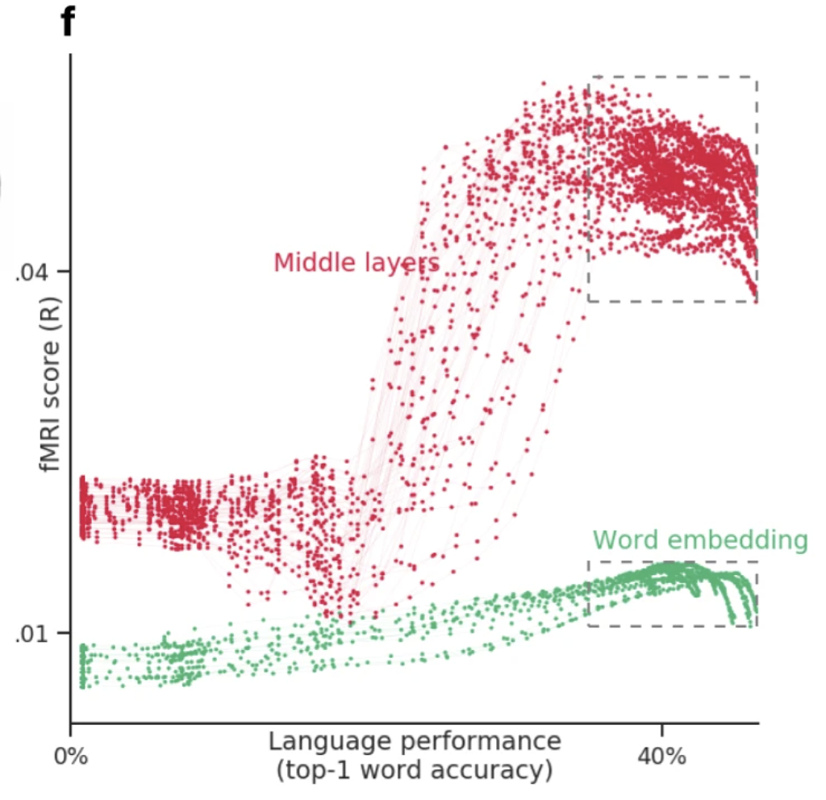
Language: work utilizing DL progress
best alignment with fMRI & MEG in middle layers
better performance at predicting next word -> better prediction of fMRI & MEg
Stimuli: sentences
Stimulus representation: derived from pretrained NLP systems
Brain recording & modality: MEG & fMRI, reading
Caucheteux, Charlotte, and Jean-Rémi King. "Brains and algorithms partially converge in natural language processing." Communications biology 5, no. 1 (2022): 1-10.

Slide 28
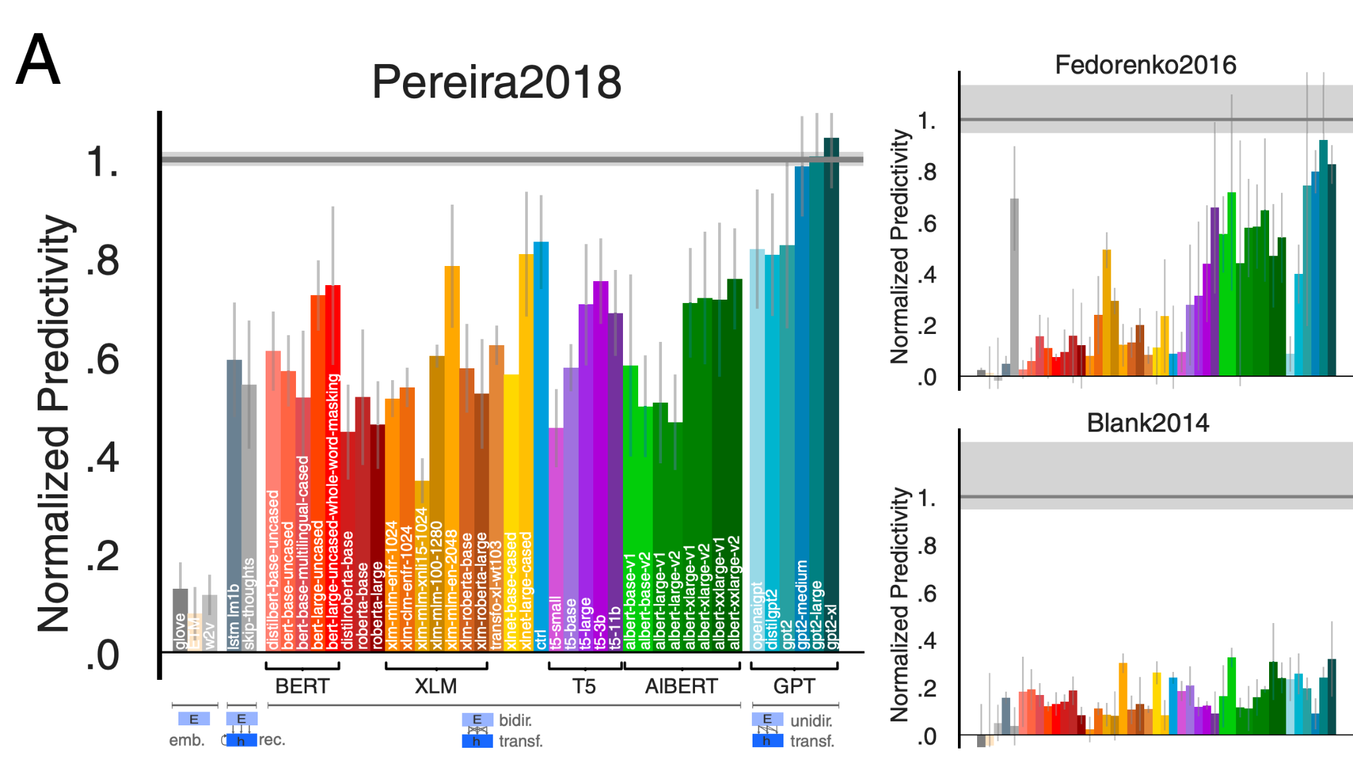
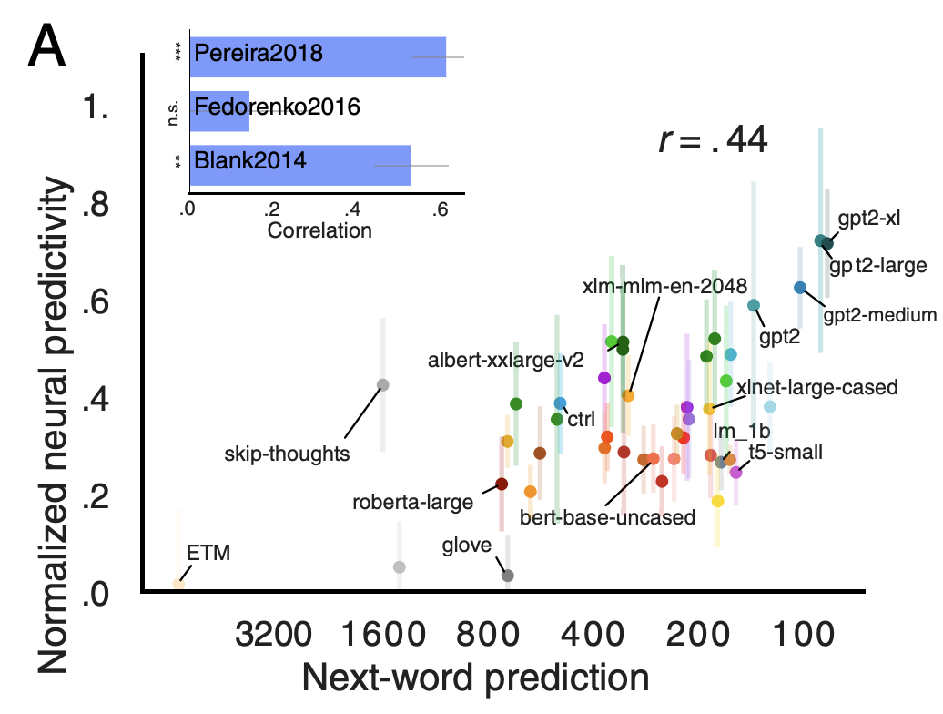
Language: work utilizing DL progress
Stimuli: sentences, passages, short story
Stimulus representation: derived from pretrained NLP systems
Brain recording & modality: fMRI & ECoG, reading & listening
some NLP systems can predict fMRI and ECoG up to 100% of estimated noise ceiling
Schrimpf, Martin, Idan Asher Blank, Greta Tuckute, Carina Kauf, Eghbal A. Hosseini, Nancy Kanwisher, Joshua B. Tenenbaum, and Evelina Fedorenko. "The neural architecture of language: Integrative modeling converges on predictive processing." Proceedings of the National Academy of Sciences 118, no. 45 (2021): e2105646118.

Slide 29
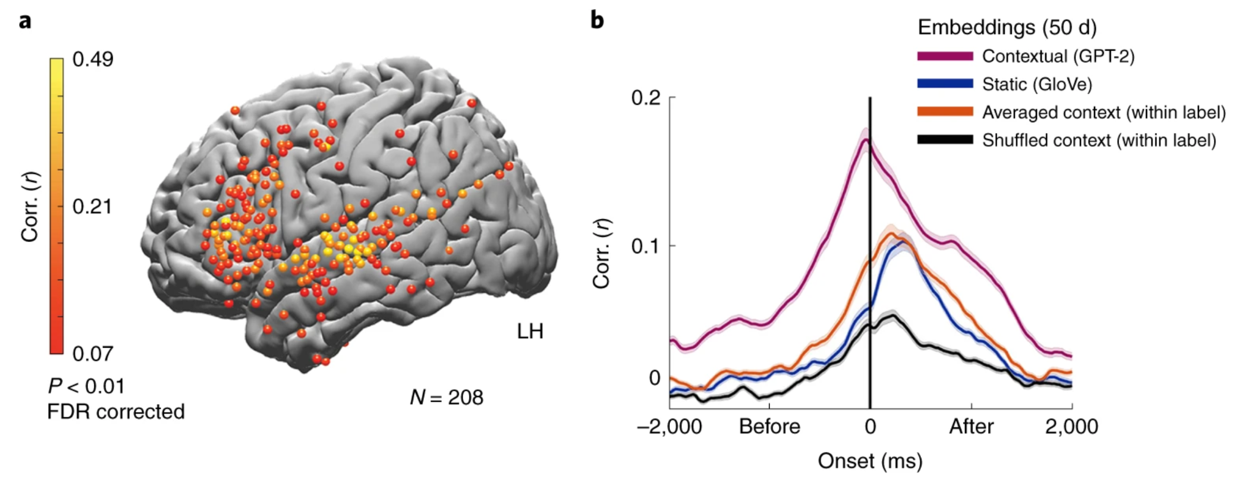
Language: work utilizing DL progress
Stimuli: story
Stimulus representation: derived from pretrained NLP systems
Brain recording & modality: ECoG, listening
NLP word representations predict ECoG recordings for upcoming words
Goldstein, Ariel, Zaid Zada, Eliav Buchnik, Mariano Schain, Amy Price, Bobbi Aubrey, Samuel A. Nastase et al. "Shared computational principles for language processing in humans and deep language models." Nature neuroscience 25, no. 3 (2022): 369-380.

Slide 30
Recent work utilizing progress in DL for encoding
Using representations of stimuli from deep learning systems
Data-driven
Language:
Wehbe et al. 2014; Jain and Huth, 2018; Toneva and Wehbe, 2019; Caucheteux and King, 2020/2022; Schrimpf et al. 2020/2021; Goldstein et al. 2021/2022
Vision:
Yamins et al. 2014; Cichy et al. 2016; Konkle and Alvarez, 2020/2022; Zhuang et al. 2022
Audio:
Kell et al. 2018; Vaidya, Jain, and Huth 2022; Millet et al. 2022

Slide 31
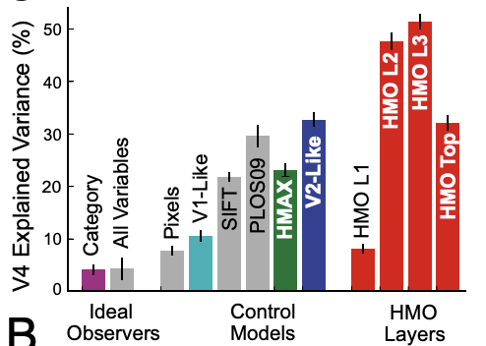
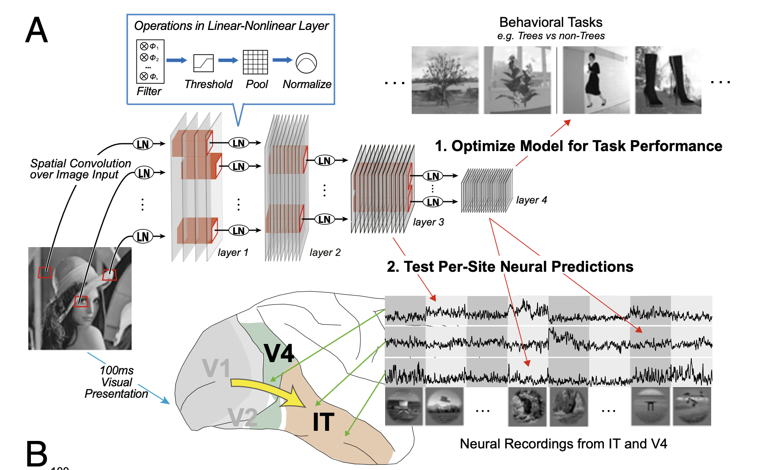
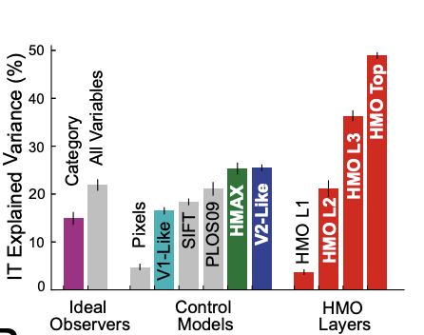
Vision: work utilizing DL progress
Stimuli: images of natural objects
Stimulus representation: layers in pretrained CNNs
Brain recording & modality: multiarray recordings in rhesus macaques, vision
Highest layer in CNN model most predictive of IT; intermediate layers most predictive of V4
Yamins, Daniel LK, Ha Hong, Charles F. Cadieu, Ethan A. Solomon, Darren Seibert, and James J. DiCarlo. "Performance-optimized hierarchical models predict neural responses in higher visual cortex." Proceedings of the national academy of sciences 111, no. 23 (2014): 8619-8624.

Slide 32
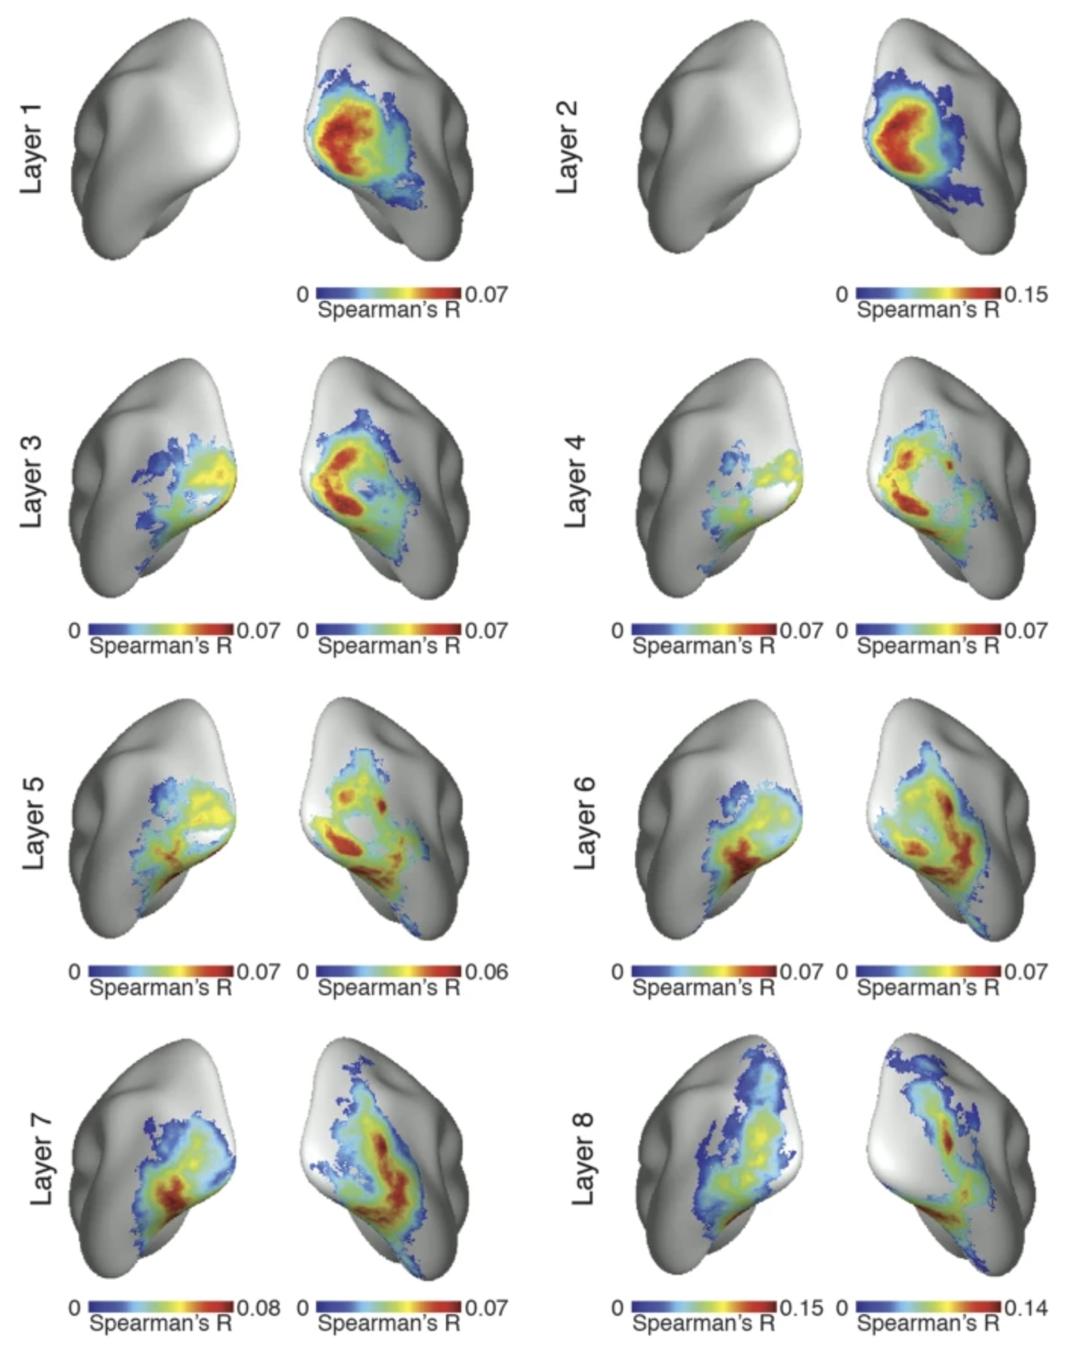
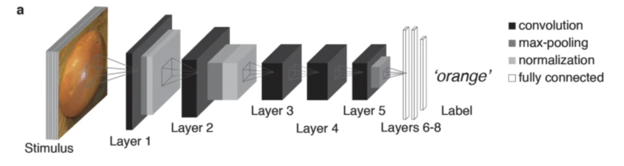
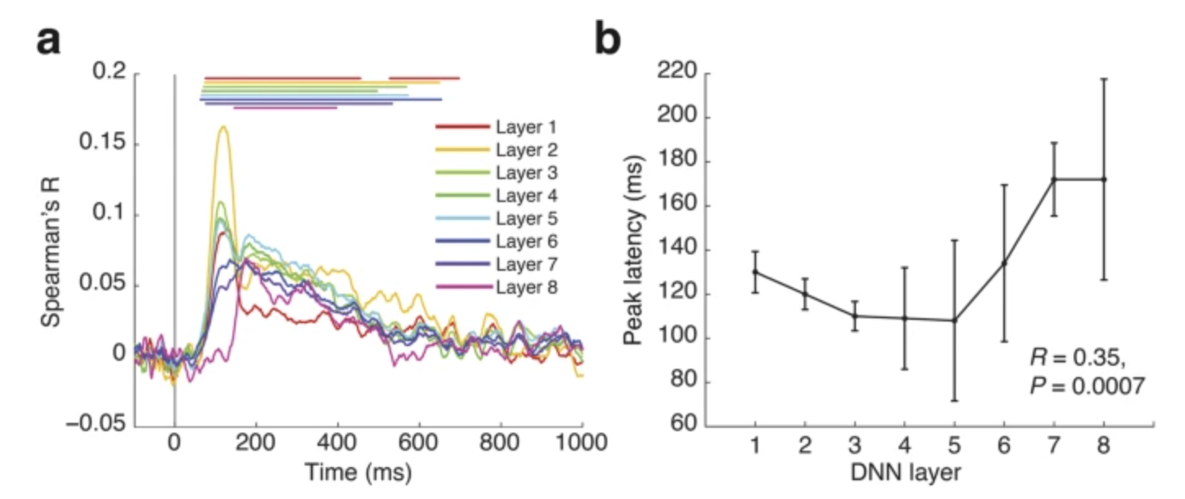
Vision: work utilizing DL progress
Stimuli: images of natural objects
Stimulus representation: layers of CNN tuned for object classification
Brain recording: fMRI & MEG, vision
A CNN tuned for object classification captures stages of human visual processing in both space and time
Cichy, Radoslaw Martin, Aditya Khosla, Dimitrios Pantazis, Antonio Torralba, and Aude Oliva. "Comparison of deep neural networks to spatio-temporal cortical dynamics of human visual object recognition reveals hierarchical correspondence." Scientific reports 6, no. 1 (2016): 1-13.

Slide 33
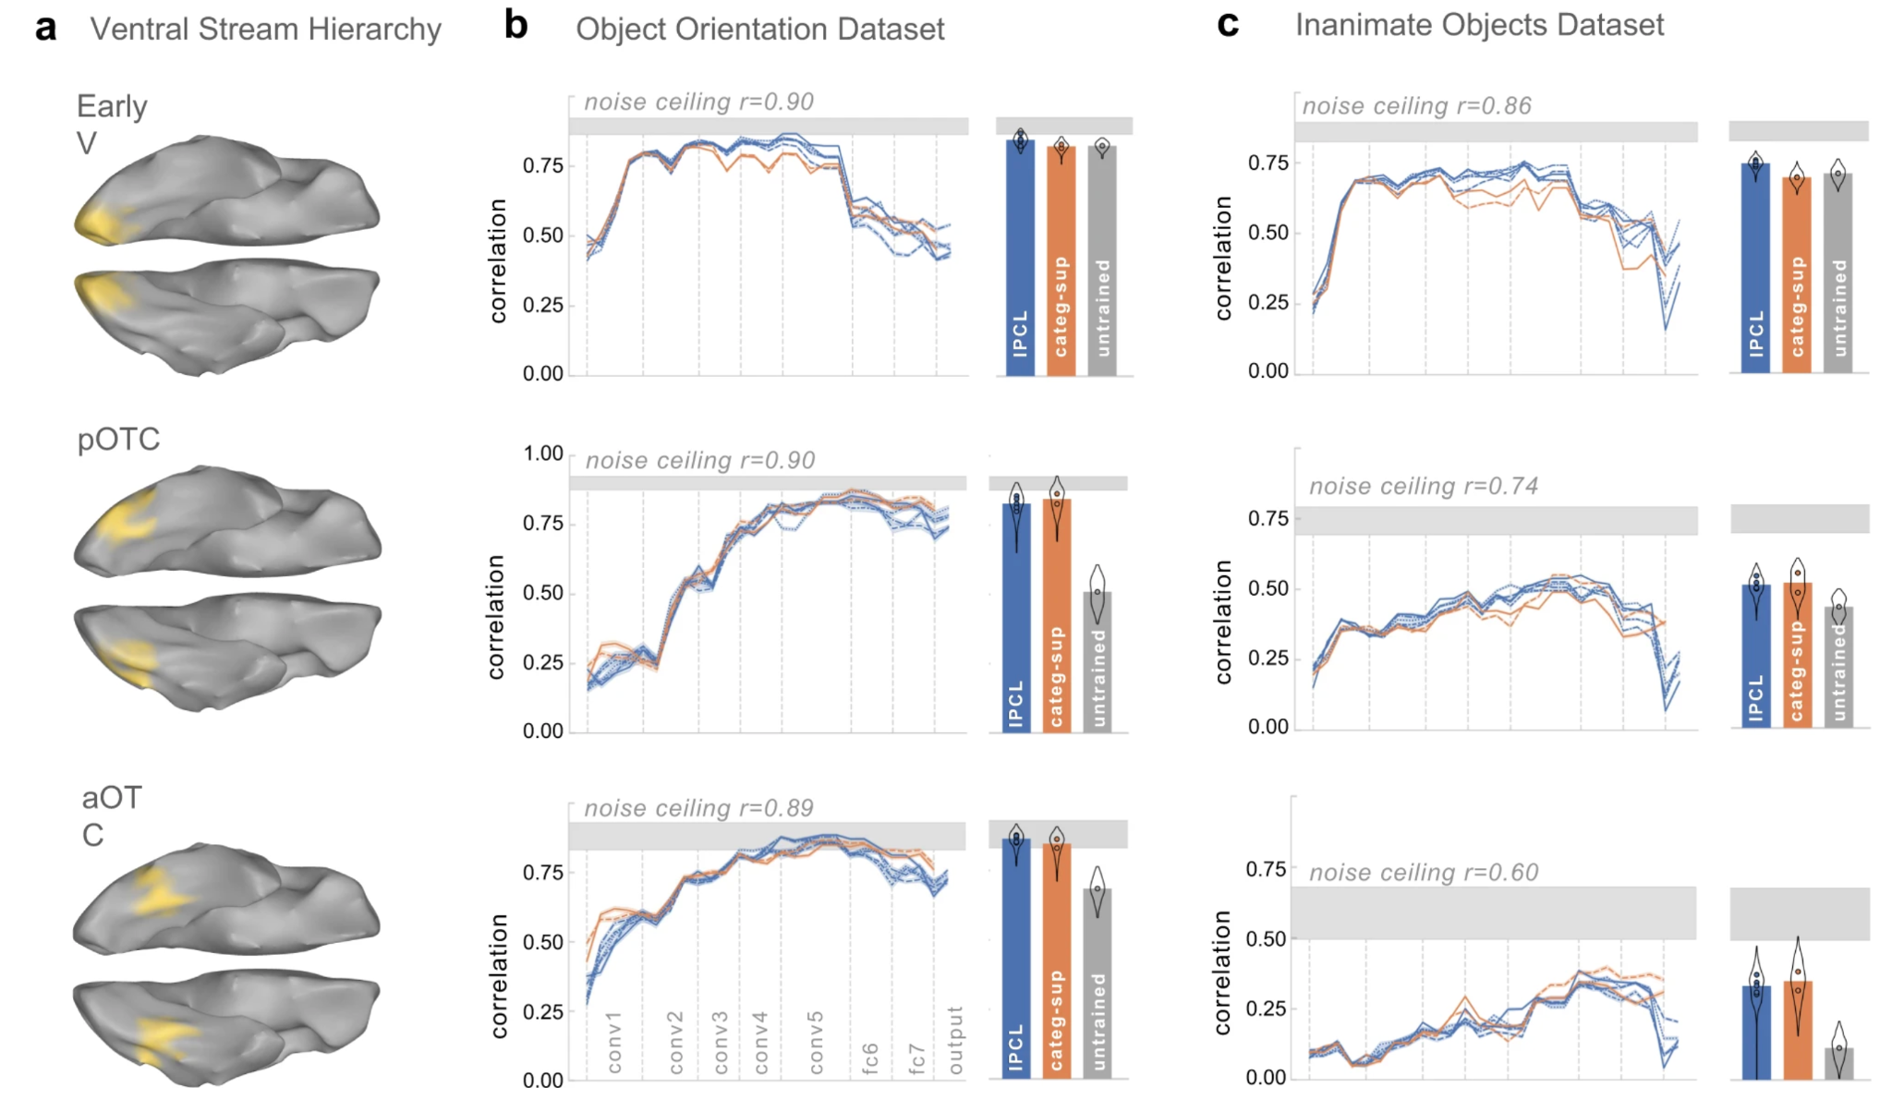
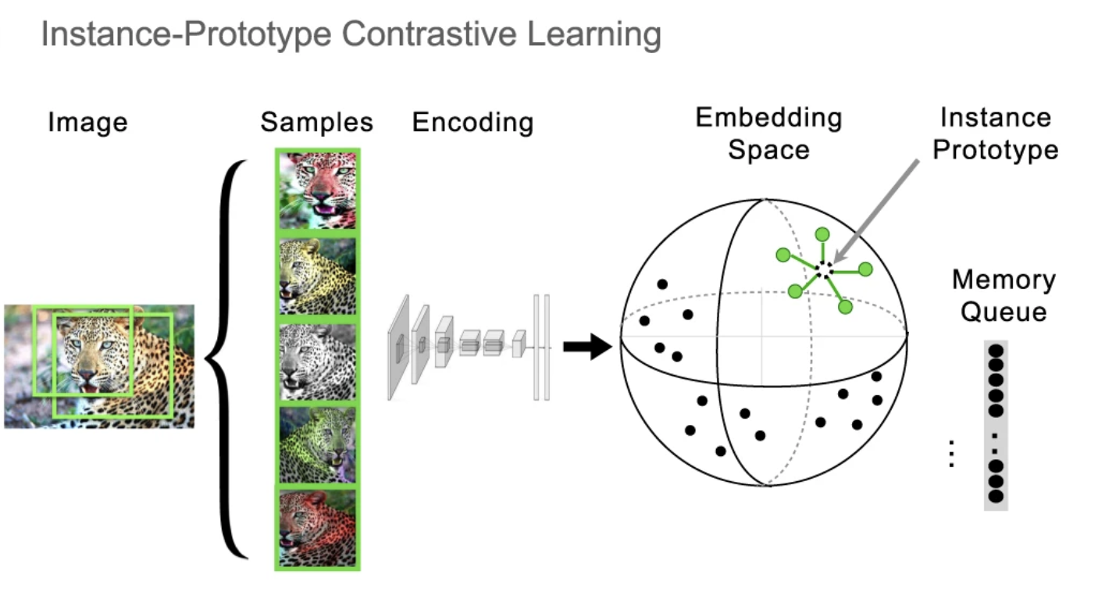
Vision: work utilizing DL progress
Self-supervised deep models achieve parity with category-supervised models in predicting fMRI responses along visual hierarchy
Stimuli: images of objects
Stimulus representation: layers in self-supervised deep model
Brain recording: fMRI, vision
Konkle, Talia, and George A. Alvarez. "A self-supervised domain-general learning framework for human ventral stream representation." Nature communications 13, no. 1 (2022): 1-12.

Slide 34
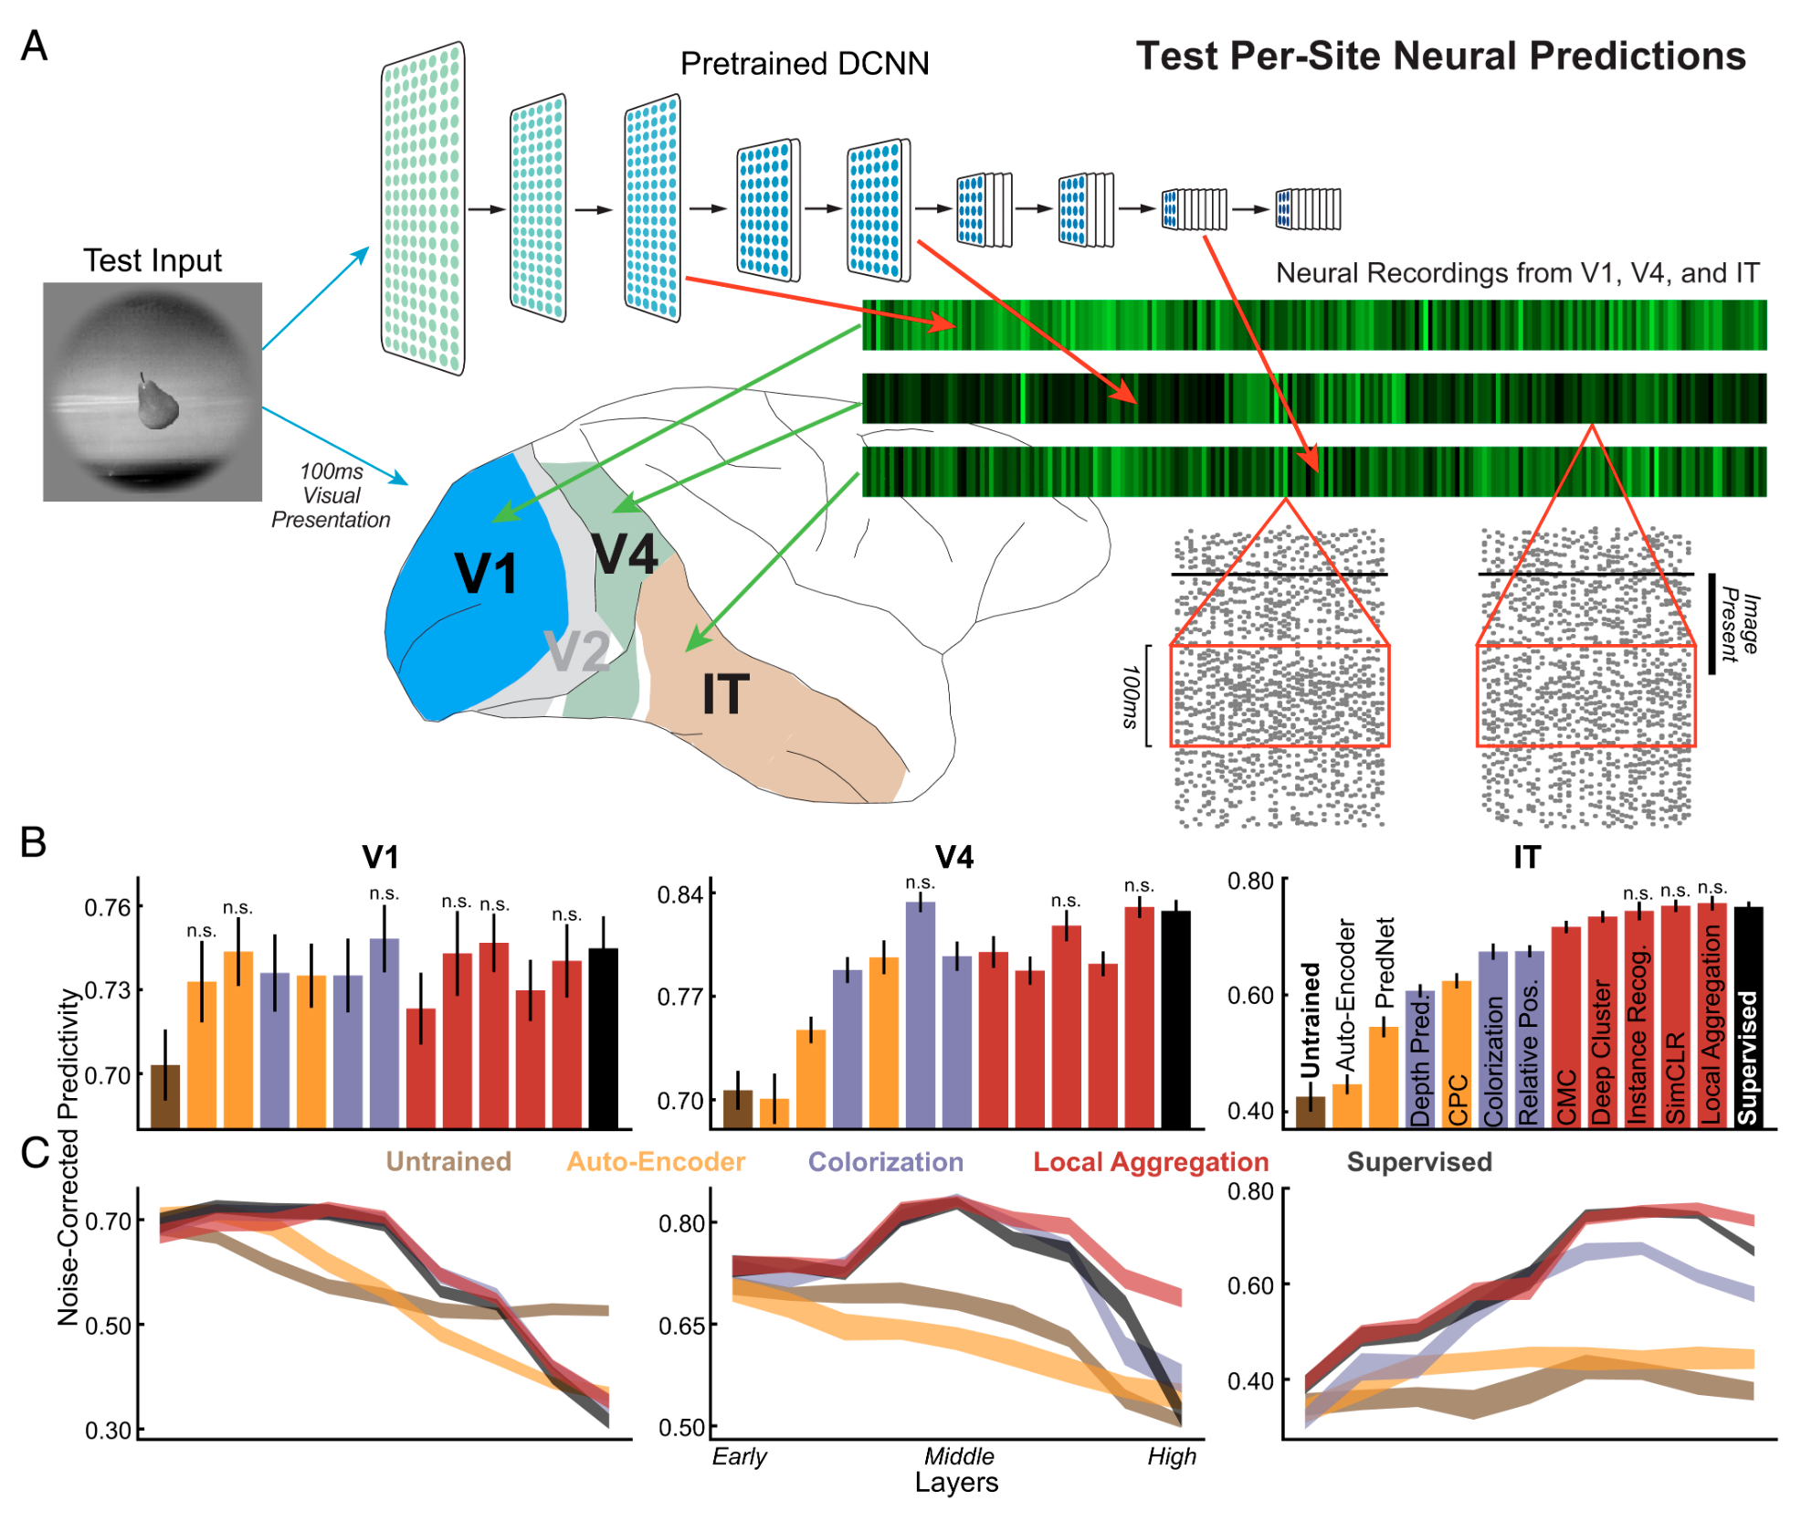
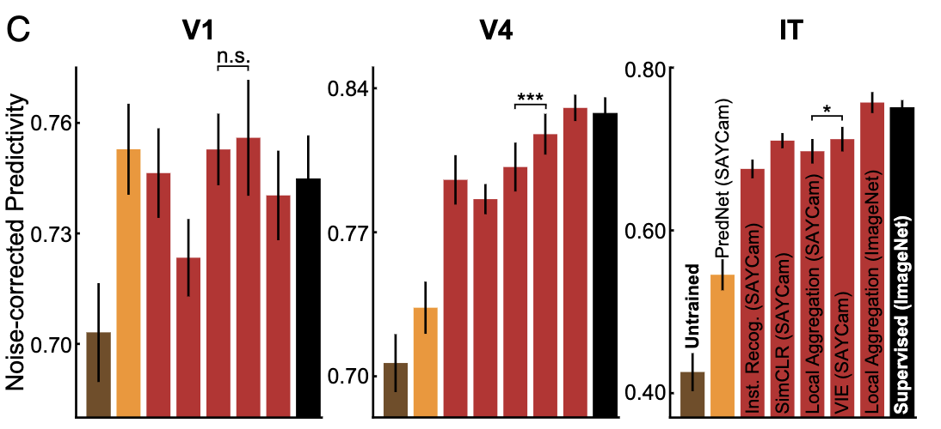
Vision: work utilizing DL progress
Self-supervised deep models produce brain-like representations even when trained solely with noisy data from child head-mounted cameras
Stimuli: images of objects
Stimulus representation: layers in self-supervised deep model
Brain recording: multiarray recordings in rhesus macaques, vision
Zhuang, Chengxu, Siming Yan, Aran Nayebi, Martin Schrimpf, Michael C. Frank, James J. DiCarlo, and Daniel LK Yamins. "Unsupervised neural network models of the ventral visual stream." Proceedings of the National Academy of Sciences 118, no. 3 (2021): e2014196118.

Slide 35
Recent work utilizing progress in DL for encoding
Using representations of stimuli from deep learning systems
Data-driven
Language:
Wehbe et al. 2014; Jain and Huth, 2018; Toneva and Wehbe, 2019; Caucheteux and King, 2020/2022; Schrimpf et al. 2020/2021; Goldstein et al. 2021/2022
Vision:
Yamins et al. 2014; Cichy et al. 2016; Konkle and Alvarez, 2020/2022; Zhuang et al. 2022
Audio:
Kell et al. 2018; Vaidya, Jain, and Huth 2022; Millet et al. 2022

Slide 36
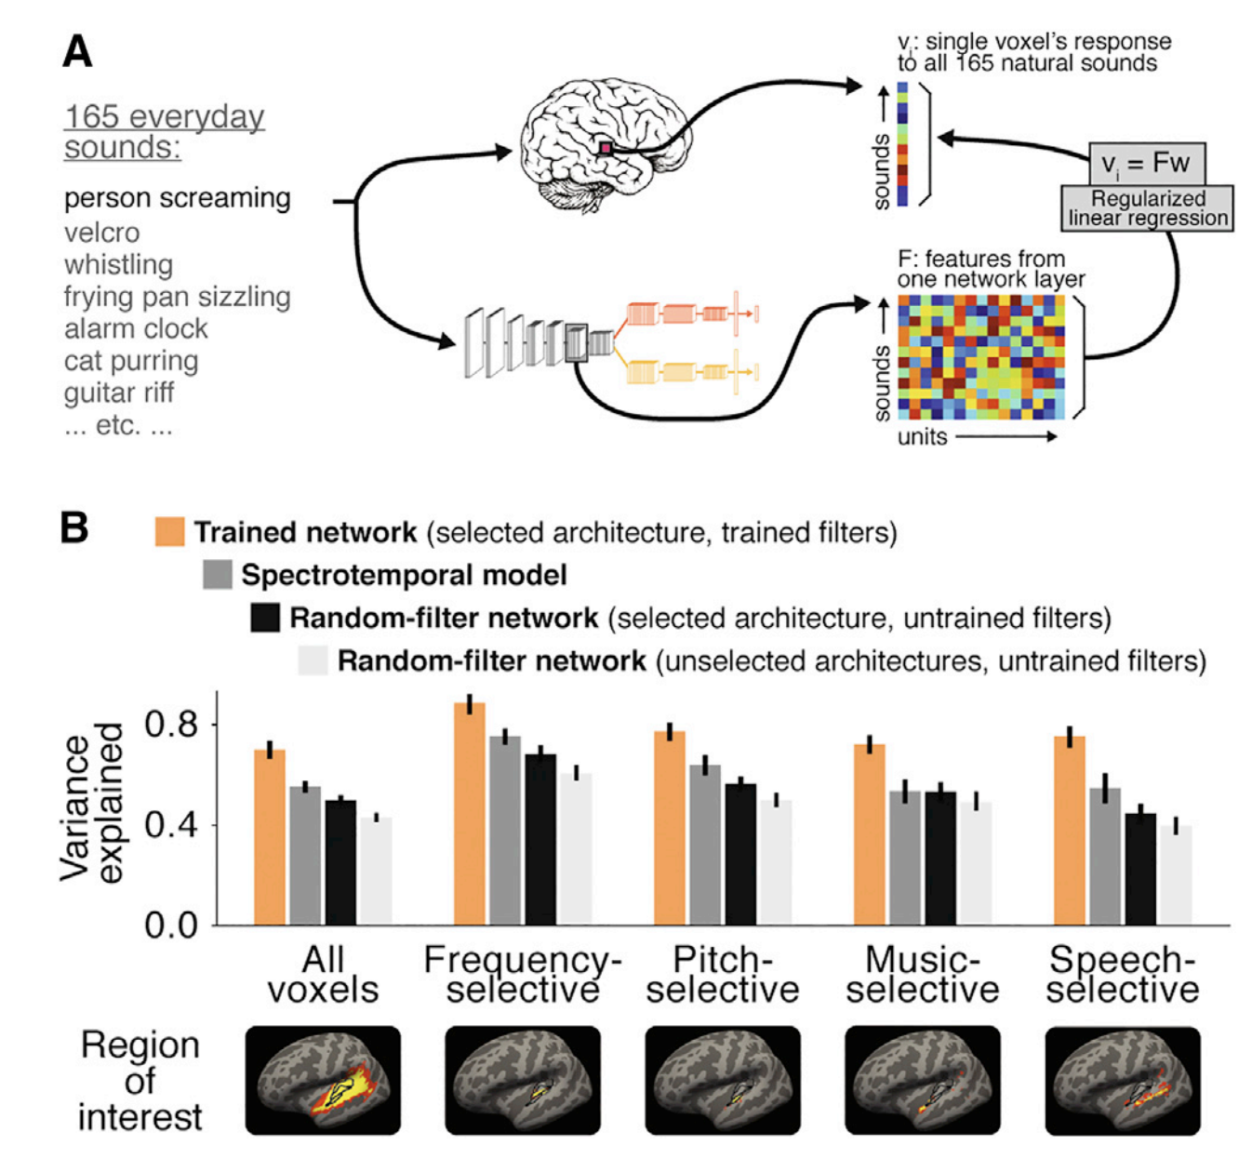
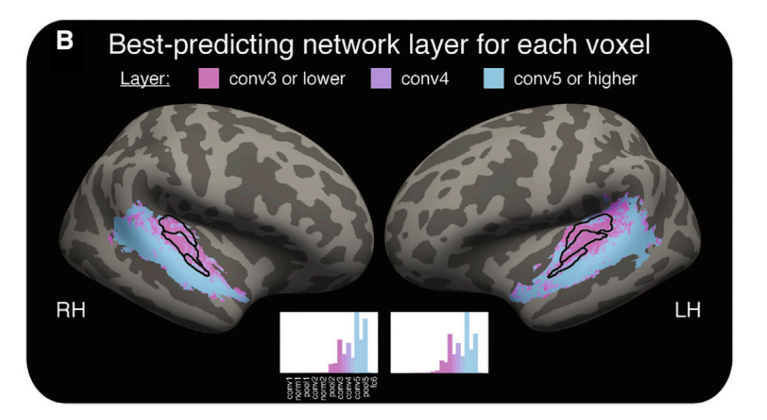
Audio: work utilizing DL progress
Stimuli: natural sounds
Stimulus representation: deep model optimized for speech and music recognition
Brain recording & modality: fMRI, listening
Primary auditory responses predicted best by intermediate layers of task-optimized model;
non-primary responses predicted best by late layers
Kell, Alexander JE, Daniel LK Yamins, Erica N. Shook, Sam V. Norman-Haignere, and Josh H. McDermott. "A task-optimized neural network replicates human auditory behavior, predicts brain responses, and reveals a cortical processing hierarchy." Neuron 98, no. 3 (2018): 630-644.

Slide 37


Audio: work utilizing DL progress
Stimuli: Moth Radio Hour
Stimulus representation: derived from pretrained self-supervised speech models
Brain recording & modality: fMRI, listening
Middle layers of self-supervised speech models predict auditory cortex the best
Vaidya, Aditya R., Shailee Jain, and Alexander G. Huth. "Self-supervised models of audio effectively explain human cortical responses to speech." ICML (2022).

Slide 38

Audio: work utilizing DL progress
Stimuli: audio books
Stimulus representation: derived from pretrained self-supervised speech model
Brain recording & modality: fMRI, listening in 3 languages (Eng, Fr, Mandarin)
Self-supervised speech models reveal specialization for native sounds in the STS and MTG;
IFG and AG show more general specialization for speech rather than native-language
Millet, Juliette, Charlotte Caucheteux, Pierre Orhan, Yves Boubenec, Alexandre Gramfort, Ewan Dunbar, Christophe Pallier, and Jean-Remi King. "Toward a realistic model of speech processing in the brain with self-supervised learning." arXiv preprint arXiv:2206.01685 (2022).

Slide 39
Agenda
Introduction to Brain encoding and decoding [30 min]
Stimulus Representations [1 hour 30 min]
Coffee break [30 min]
Deep Learning for Brain Decoding [1 hour 30 min]
Lunch break [1 hour 15 min]
Deep Learning for Brain Encoding [1 hour 30 min]
Classic findings & common approaches
More recent findings utilizing deep learning
Coffee break [30 min]
Advanced Methods [1 hour 15 min]
Summary and Future Trends [15 min]

